Slide 1
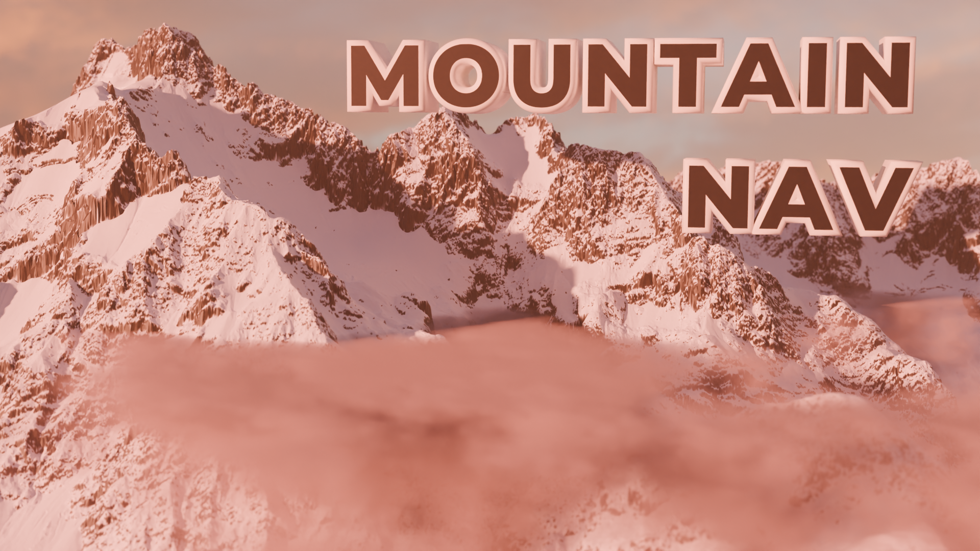
Improving Resort and Backcountry Mountaineering Safety
Project Code:
https://github.com/mr-yak/Mountain-Nav
Builds:
https://drive.google.com/drive/folders/1DbxUUI5ljrBoTPdJd-6Vy7oaxTvZTcuZ?usp=sharing
Product Demonstration Video:
https://youtu.be/OEGwWNFQr2I
Jack Shaw
91608, 91610, 91611, 93601
NSN: 139681887

Slide 2
Table of Contents
28 Adding Transitions and Trails
29 Picking Hardware (SBCs)
30 More Performance Optimizations
31 Material Choice Evaluations
32 Manufacturing Methods
33 First Case Prototype and Testing
34 Redesigning the Case
35-36 Input System Design and Manufacture
37 Further Refinement and Prototyping of the Case
38 Button Design and Manufacture
39 Final Renders of Design, Analysis of Brief
40 Thermal Management of CPU
41 Working Prototype and Droid Manager
42 Text Design – Concepts
43 Text Design – Final Concepts and Animation Changes
44 First Aid and Other Landmarks
45 Backcountry – Mt Murchison
46 Backcountry - Detecting Dangerous Land Features
47 Performance Overview on OrangePi 5 Pro
48 Final Windows Build and Project Video
49 Issues during 1st attempt at final assembly
50 Final Assembly
51 Promotional Renders/Advertising
52 Finished Product and Reflection
53 Stakeholder Feedback and Reflection
54 Areas of Future Development
55 Acknowledgements
3 Context Exploration
4 Deeper Context Exploration
5 Stakeholder Identification
6-7 Stakeholder Survey
8-9 Contacts (Ski Patrols and NZMSC)
10 Exploring the Issues
11 Statement of Intent
11 Analysis of Need
12 Social Acceptance and Stakeholder Feedback
12 Materials in the Physical Environment
13 Conceptual Statement
13 Attributes
14 Existing Products Research
15-16 Initial Specifications
17 Gantt Chart
18 Critical Review Points
19 Hardware Concepts and Ideation
20 Software Concepts
21 Beginning of Software Development
22 Sentinel 2 Textures
23 High Resolution DEM and Satellite Issues
24 Texturing the High Res Model
25 Creating the Map Menu
26 Animations and Background
27 Performance Optimisation – Vertex Reduction

Slide 3
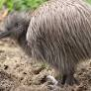
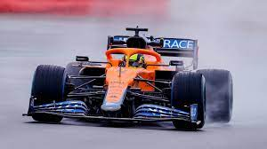
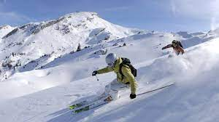
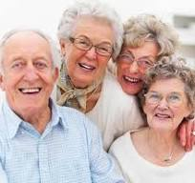
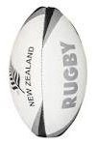
Context Exploration
This brainstorm allows me to identify contexts which may have a problem that I could solve with my project
Transportation systems are essential for society to operate, and fun transportation systems like F1 cars can also be used for recreation
In New Zealand, we have many unique species. It is very important that we preserve our native wildlife for future generations to enjoy
Wildlife
Skiing
Transport
Contexts
I love to ski, and so do many others. How can skiing become more convenient, safe and affordable.
Ageing and the elderly
Sports
Ageing affects every part of a person's life. It is essential that we help elderly people to have a reasonable quality of life.
Sports are a way for people to relax, but can also be very competitive at a club or international level.
3

Slide 4
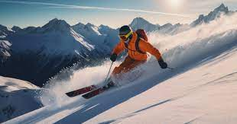
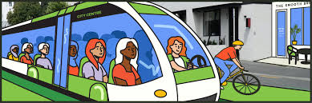
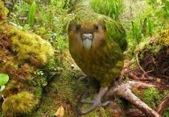
Deeper Context Exploration
Digging deeper into these contexts allows me to better understand which context to further explore.
Skiing
Transport
I picked this context as skiing is one of my favorite things to do, and it is a very popular recreational activity.
I picked this context as it is very important in modern society to get from A to B as efficiently and quickly as possible
Wildlife
I picked this context as I think our native species and our landscapes are an invaluable asset to our country
Skiing is heaps of fun, and improves mental health of skiers
Skiing allows people to explore New Zealand's Mountains
Various forms of skiing features at the winter olympics.
Skiing takes place in very cold, windy and harsh environments
Transport has been important throughout human history
Transport can involve moving people, or moving things
Complex transportation infrastructure is essential for a modern society
Efficient personal transportation allows people to be efficient with their time
New Zealand has an amazing array of native species.
Preserving our natural wildlife is our responsibility as kaitiaki of the land.
Wildlife preservation involves pest control, research and rehabilitation.
4

Slide 5
Stakeholders Identification
Consulting with stakeholders is important as it allows me to find a need and an opportunity in the context.
Department of Conservation
Mr Dymock
DOC is still relevant in this context, as they have expertise in how any product will affect the environment. I will still contact them through email
Mr Dymock plays the same role with this context, helping me with the engineering and design of my project. I will still contact them at class time.
Ngai Tahu - Local Iwi
Skiers and mountain users
Similar to above, the local Iwi has knowledge about the area, and will know how the wildlife in the mountain works. This will help the project not have any unintended consequences on the environment. I will contact Ngāi Tahu through email.
Skiers and mountain users are the main users of the mountain. They may end up being the main users of the product. I will contact them through various skiing forums, and will use forms to try and get a general view of the whole skiing and snowboarding community. This also includes a Arctic soldier that I know, that will have knowledge about mountain environments
Ski Fields
The Ski fields run the places where most people ski. They will be very important, as they know how the ski field operates. This could help me get insight into what could be a useful product for the ski field, and what are the limitations of the mountain environment. I will contact the ski fields through email
NZ Mountain Safety Council
The NZ Mountain Safety Council is an organisation that provides resources and help for people looking to explore the mountains. Consulting with these people will be very useful, as they will be able to give me information on mountain environments, and also information about what will be helpful for my end users.
Finding Contacts with expertise in mountain safety is a key part of research and stakeholder consultation
5

Slide 6
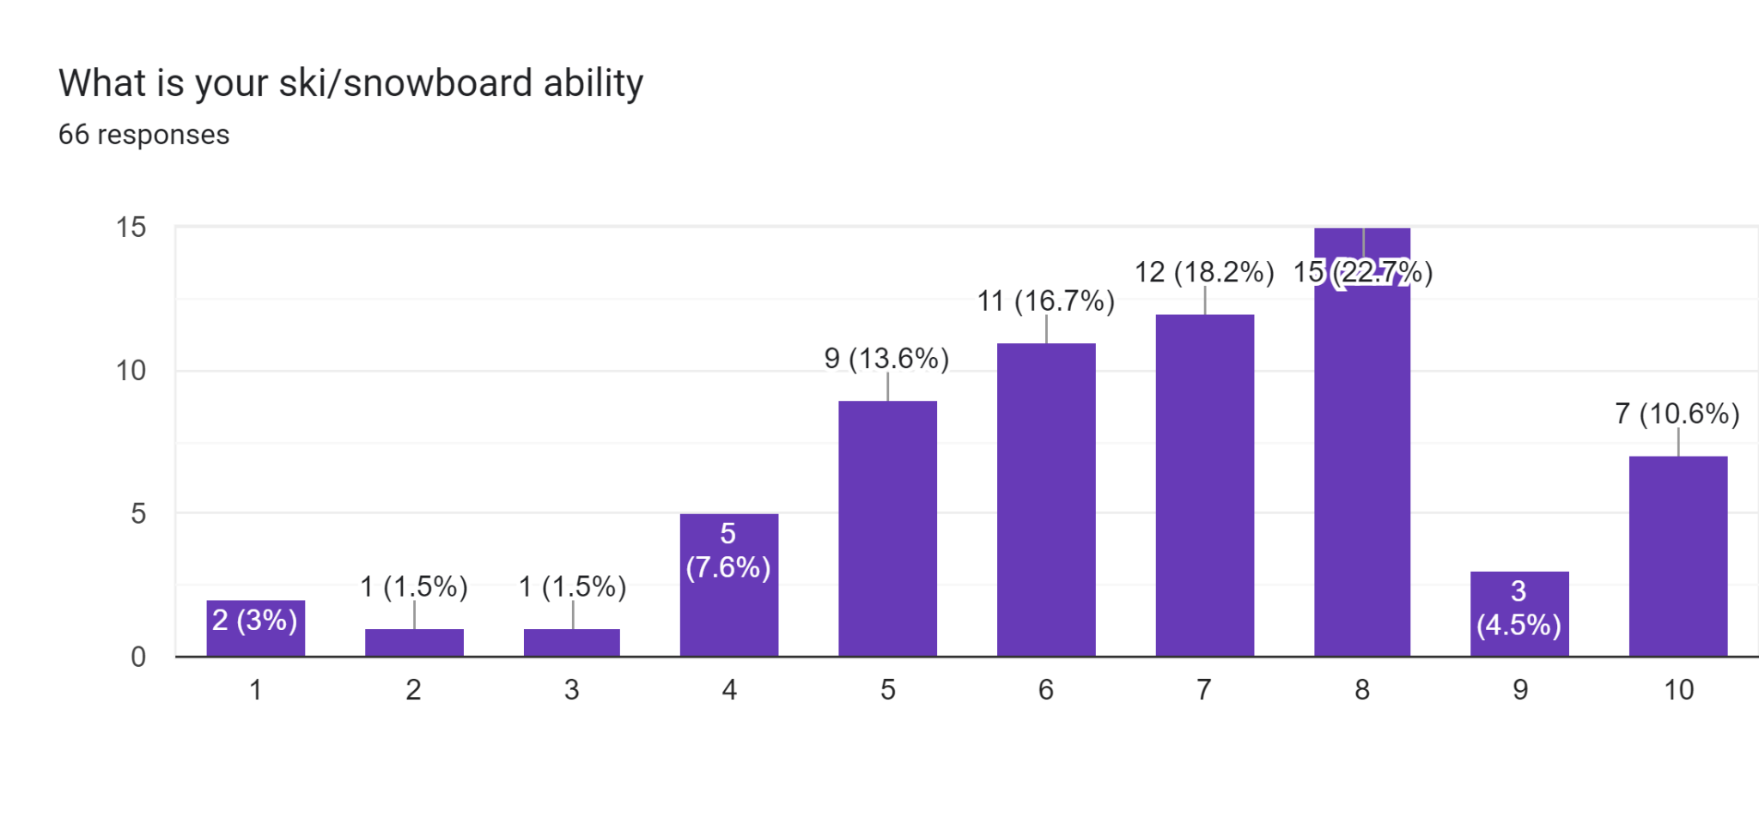
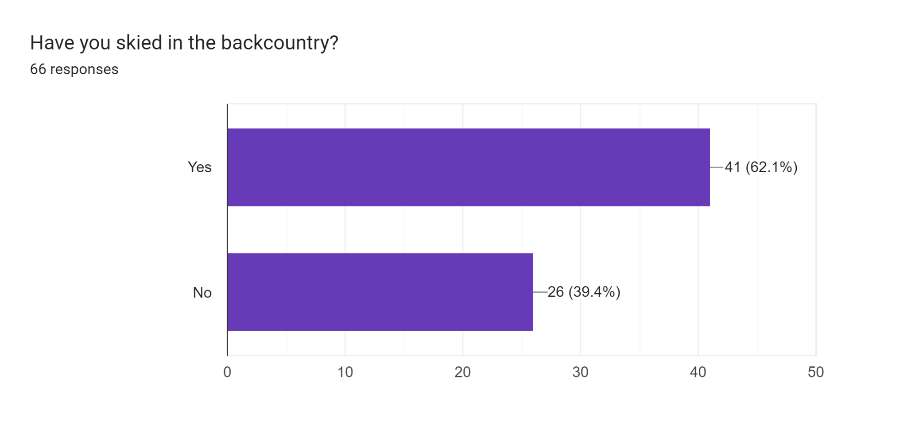
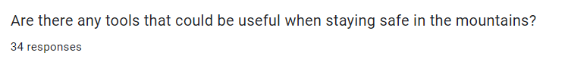
Stakeholder Feedback - Mountain Users
Bar Charts
I decided to send out a survey to Mountain Users in the school to try and understand what this group of stakeholders needed as a product. To start, I asked What their Ski/Snowboard ability is. As can be seen in the bar chart, there is a large population of skilled Skiers/Snowboarders, with the most common response being 8/10. The average rating someone gave themself was 6.65/10. This means that the population that I am sampling are proficient skiers and should have good feedback for my project. The next question I asked is if they have skied in the backcountry. The majority of them(62.1%) said that they have skied in the backcountry. This means that you would expect that most of these people have experience in backcountry, and that they will know a lot about
Useful Tools
I got a lot of good ideas for potential projects from this question. A lot of people said that a GPS beacon would be a good idea. This is a good idea, however there are already very similar products on the market. Similarly, flares were suggested a lot. Helmets were suggested a lot, but these days almost everyone wears a helmet on ski fields and in the backcountry, it isn’t really creating something new. Another common suggestion was a trail map. These are very useful in the ski field, but aren’t available for the backcountry. Additionally, paper trail maps are a pain to use. Lastly, A lot of people suggested high vis clothing for the ski field. There isn’t a lot of high vis ski clothing available that I have seen, but people do care about their fashion and would rather ski/snowboard in something that looks nicer.
Beginner Expert
6

Slide 7
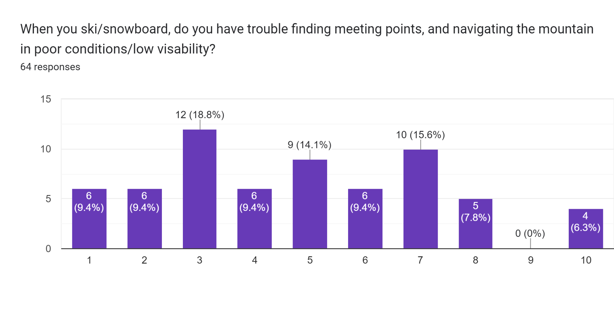
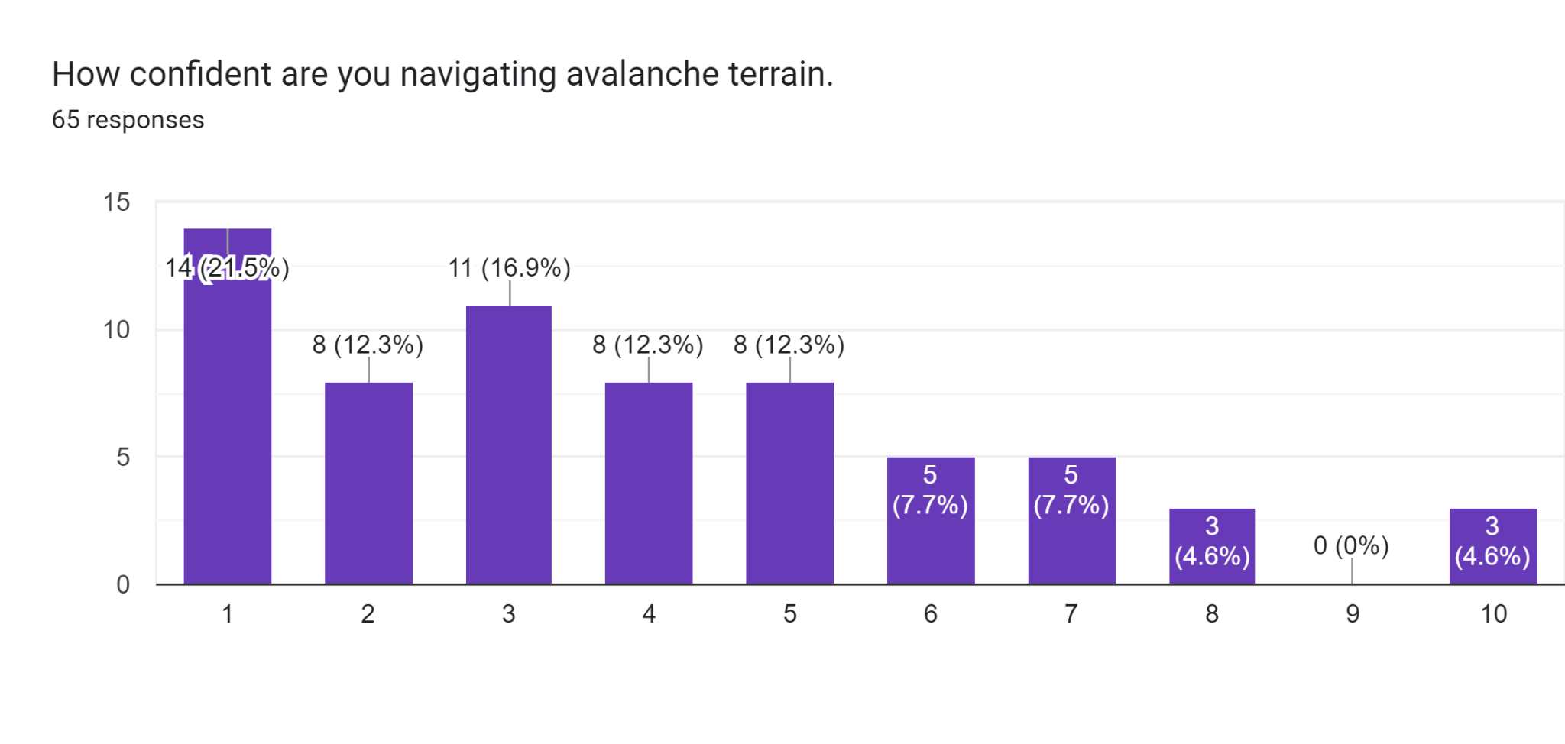
Stakeholder Feedback - Mountain Users
It is clear that the skill level of skiers in the sample group is quite high. However, some of them still have trouble navigating in poor conditions. However, the results were quite spread out, with many not having trouble at all. Although the average result was approximately 4.828, the variance of the data was large enough that this is a significant issue for a portion of the people surveyed. 29.7% of surveyed people gave a score of 7 or above. It is also possible that some of the people that gave lower numbers haven’t experienced really poor weather, making them unaware of these difficulties. The next question I asked was whether the respondents were confident navigating avalanche terrain. As 62.1% of respondents said they have skied in the backcountry, I expected that a reasonable proportion of respondents would be very confident navigating this terrain. However, the results were concerning. The most popular option was 1, which was the lowest score available. The average score was approximately 3.908, also very low for a group that has mostly been in the backcountry. This data clearly demonstrates a low confidence in avalanche safety among skiers in the backcountry, and it is clear that skiers might need help while in the backcountry when navigating avalanches, and perhaps a tool that helped would be beneficial to skiers safety. After this survey, I decided to contact my other stakeholder for their expertise and feedback, and the data I have collected has told me I need to make avalanche safety part of my questions to these experts.
Easy Hard
Not Confident Confident
7

Slide 8
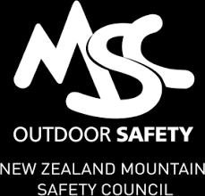
Contacts - NZ Mountain Safety Council + Ski Patrol
NZ Mountain Safety Council - Bianca
I would encourage you to take a look at the Mountain Safety Council website, you will find all of the answers to your enquiry along with resources to support these too. The NZ Land Safety Code has been created to prioritise the most important details when planning and undertaking a trip in the backcountry. View the following information –
https://www.mountainsafety.org.nz/learn/resources/land-safety-code. Regarding navigation, we have a specific page with information about navigation and tools available
https://www.mountainsafety.org.nz/learn/skills/navigation The following webpage includes some great information about avalanche safety and navigating avalanche terrain.
https://www.mountainsafety.org.nz/learn/skills/avalanche-safety. The NZ Avalanche Advisory ‘Education’ section also hosts a wealth of information, including a short online course and a ‘Trip Planning’ section that will be most helpful for your assignment
https://www.avalanche.net.nz/education/trip-planning
I’m confident you will find a wealth of information to inform your project there. If any additional questions come up, please feel free to get in touch.
Craigieburn Ski Patrol
1. What are some of the main risks on the ski field?
For the public the biggest risk is injury - particularly for beginner and intermediate skiers & borders. Skiing contributes to almost half of all ACL injuries submitted to ACC annually.
2. Do you have trouble finding people when they are skiing. In New Zealand almost all skiing is alpine (no trees) so locating people in good weather is not a problem. If visibility is poor we typically close terrain and keep people within more confined areas.
3. How can you keep safe while skiing?
Follow the snow code!
https://www.nzski.com/media/1099/new-zealand-snow-code.pdf
4. Do people get lost while skiing on the mountain?
Yep! usually due to poor visibility. This is usually mitigated by terrain closures. In larger resorts i.e. USA or Canada people will call patrol saying they are lost - usually in the trees, we will often use there GPS Location from their phone to find them and take them back to the main trails.
Questions For Ski Patrol
1.What are some of the main risks on the ski field?
2.Do you have trouble finding people when they are skiing?
3.How can you keep safe while skiing?
4.Do people get lost while they are mountain skiing?
8

Slide 9
More Ski Patrol
Whakapapa Ski Patrol - Mike
See previous page for Questions
1.) Skiing is an inherently dangerous sport with risk of falling or colliding with rocks, other skiers or objects on the runs such as lift towers. Weather can be a factor as well depending on the conditions we experience. Becoming cold can be dangerous if we are experiencing poor weather. On the other hand if it's a beautiful day, sunburn and dehydration can be a factor. If you are a responsible rider and obey all the alpine rules, have good judgment and decision making; a lot of these hazards are easily avoided.
2.)Currently with the terrain we have open and inbounds at Whakapapa we can easily locate people. However, should we have more terrain open it can be an issue. It's always worth knowing where you are on the mountain or what ski run you're on. This will ensure you can easily relay that information to us & we can locate you faster in the event of an emergency.
3.)Dress appropriately for the conditions, usually having extra layers and gloves to keep warm. Ski within your ability level and know where you are on the mountain. Keep hydrated and fed. Take breaks regularly to avoid fatigue. Have a meet up point and time and be sure to show up on time. Always ski with a friend. Wear protective equipment (helmet, back protection, wrist guards for snowboarders). Always stay within the ski area boundary and obey signage that patrol puts out. Feel free to approach patrol with any questions or concerns you may have. Also if you or anyone you know is travelling outside of the ski area boundary, be sure to have proper avalanche PPE (probe, shovel, beacon, ice axe, crampons, communication device, travel plan, first aid kit.
4.)Yes, people can become disoriented while skiing and may ski into unfamiliar terrain. Or if conditions aren't ideal such as blizzards or heavy fog, people can go off trail. We put signage and ropes up to avoid this, but we can't mark everything out there. It's recommended to slow down or completely avoid riding if conditions are poor, and most likely we will have closed sections of the mountain if the conditions are too risky. This is why it's always a good idea to ski with a buddy and have check-in times and locations established. On the other hand, if it's a good ski day just be aware of trail names and have a trail map to point you in the right direction.
Cardrona/Treble Cone Ski Patrol - Grace
1.) Some of the main risks on the ski field are the constant changing weather conditions, avalanche, ice on the snow surface, and collisions.
2.)When it is low visibility conditions, it can be challenging to locate guests. Patrol will use markers around the ski field like lift tower numbers to help locate the guests.
3)The best way to keep safe while skiing is to always wear a helmet, check your equipment, ski with friends, and always abide by the snow code and the resorts signage.
4)Our signage at Cardrona is quite good, but sometimes people can find themselves on the wrong run during a low visibility day. But thanks to our amazing patrol and dispatch team here at Cardrona, we are able to locate the guests and help them get down safely.
9

Slide 10
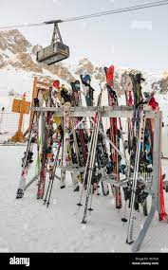
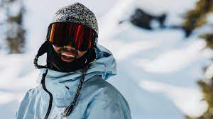
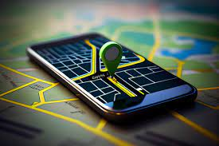
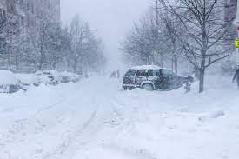
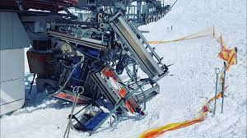
Issues in chosen context: Skiing
Goggles
Securing Equipment
During breaks, Equipment can become unsafe if not secured. Currently the only place equipment is stored is on a communal rack, increasing the risk of stealing. Stakeholder: Skier forum
When Skiing or snowboarding, your goggles can fog up if you are exerting yourself. This can cause a reduction in vision, potentially causing a crash. Stakeholder: Skier Forum
Skiing Issues
Navigation
On large mountains, It is easy to get lost. To find your way, it is very inconvenient to use a paper map, and it can be hard and unsafe to get to the base. Stakeholder: Skier forum
Lift Issues
Weather
I contacted my stakeholders to find issues that I could address. These are the issues I found. I sent out a form to the ski forum, here are the results: Form
The Weather can be bad, causing skiers to be unhappy as they can’t ski because of lift closures, or that there is no snow to ski on. Stakeholder - Me
Sometimes the lifts to get up the mountain can be unreliable and maintenance can cause people to be trapped at the bottom of the hill Stakeholder: Skier forum
10

Slide 11
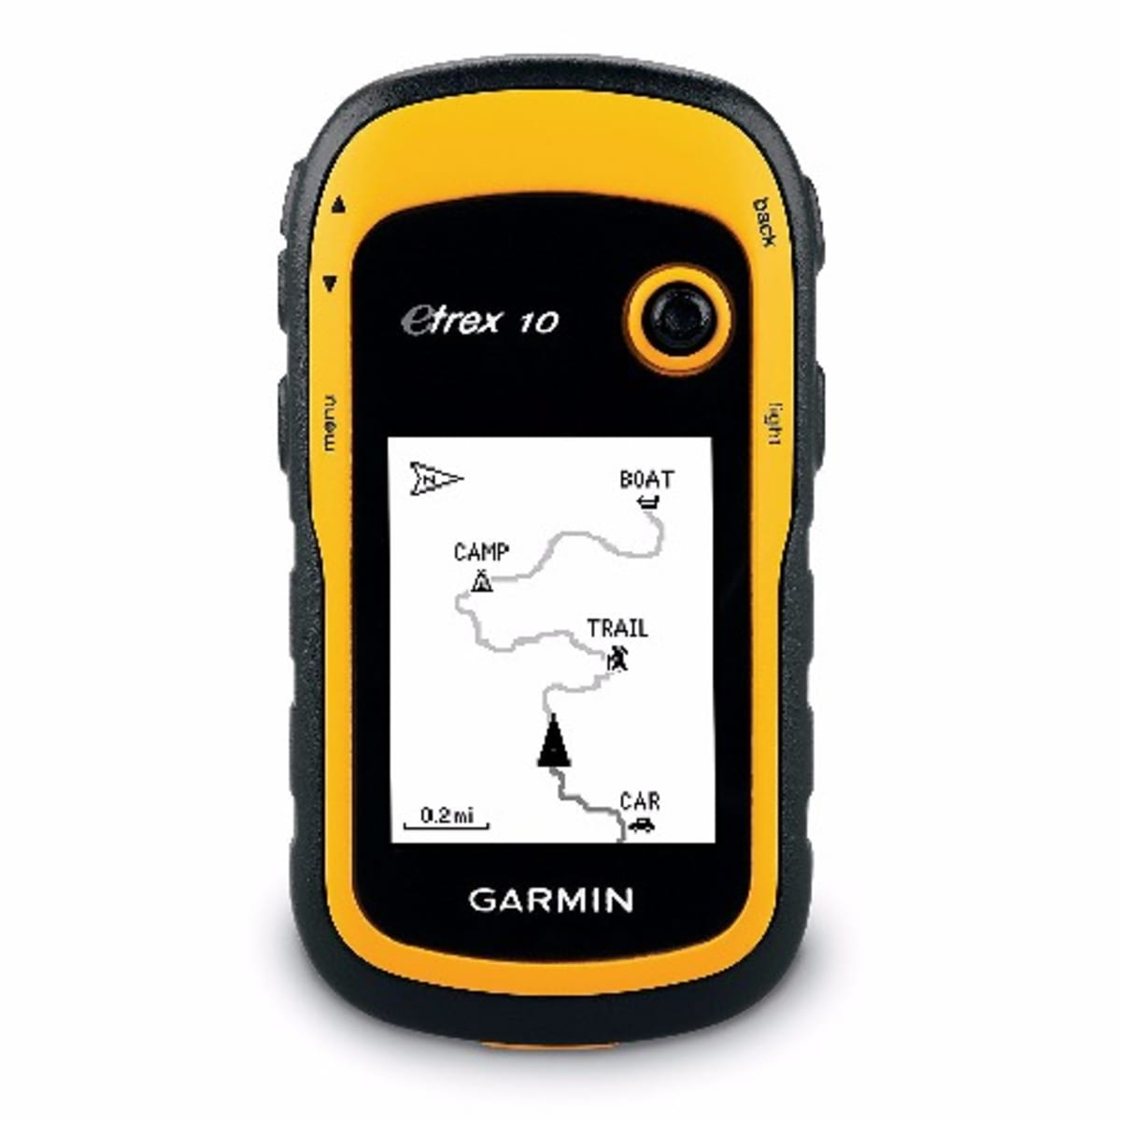
Statement Of Intent
Analysis of the need
Need
Opportunity
People get lost in the backcountry, or can end up stuck above runs that are too hard for them. This can end up being dangerous, and may cause people to fall, causing serious injury. This creates a need for some navigation system to help keep people safe on the mountain.
This need creates an opportunity for a handheld navigation system, that is specially made for skiers to navigate on piste and the backcountry.
From my research, and stakeholder consultation, I found a need for a personal navigation device for use when skiing. There is a need for this for skiers in large ski areas, and for people in the backcountry. The Mountain environment is a very special place, and it is important that the product is suitable for this environment. The Mountain is cold, and my design must account for this. The cold can affect electronics, and make them malfunction, and can also affect the properties of the materials that I use. The mountain is also a very important conservation area, so it is important that we leave no trace. The wildlife can be very delicate, so my product must not damage the mountain ecosystem. I have discussed this need with the target market for the product, skiers, and they all said that they all would consider my issue to be important, and they would be interested in buying a product to fill the need of navigation on the mountain.
The main challenge of the mountain environment is the extreme cold, and this has an effect on the materials that will potentially be used in the design.
11

Slide 12
Stakeholder reflections and social acceptance
I have discussed my need with skiers in my class to talk about their specific requirements for the outcome, and to get stakeholder feedback. They mentioned that the outcome must be easy to use, intuitive, and simple. It also must provide accurate navigation, and must be clear. They also said that the LCD screen must be easy to see in varying lights and conditions, and that it must be lightweight and easy to transport . DOC and the Iwi will want the environment to be pristine, so the device must not damage the physical environment in any circumstance. I also asked them if they think they will use the product. Most of the people I talked to said they thought the product will be useful, and would use it regularly. They said that making sure it was easier to use than a map or a phone would help. I think that a device such as mine will be beneficial to the safety of skiers, both on a ski field and backcountry.
Materials in the physical environment
Materials (See Slide 30)
PLA
Cold temperatures don’t affect the mechanical properties of PLA, however the bonding between the layers of PLA can be affected slightly by the cold, although this effect is very minor.
ABS
ABS performs well at low temperatures. It is said to keep its mechanical properties down to -20C
Screws and metal Parts
Any metal parts will be thermally conductive, and cold to touch. It is important to keep this in mind, as this could
Electronics
Components and wiring
Extreme cold can cause the resistance within wires to increase, causing issues and decreased performance, however this is not major. A problem could be condensation on the system, but the system should be warmer than the surroundings.
Batteries
In the cold, the rate of the chemical reaction inside the battery decreases. This may result in the battery not being able to provide the current required for the circuit to function properly.
12

Slide 13
Conceptual Statement
Attributes
I will be making a navigation and safety device that helps skiers navigate ski fields and the backcountry. The purpose of the product is to fulfill the need for people to navigate in mountain environments. My product will ensure that people can safely explore the mountains, and if they are in any trouble my product will be able to give search and rescue a locator beacon. It will also reduce the load on search and rescue, as it will decrease the amount of people lost in the backcountry. The target audience of my product is skiers around the country who will frequent the mountains. These people would use my product for safety, and to find new ski areas. My product will be operating in the mountain environment, and will be carried by the user while they are adventuring. The product should improve the safety of the user, whilst having minimal damage on the environment. I need to research the main risks of the mountain environment, to add features to the product, and I need to explore existing products to get design aspects and ideas. If all of these specifications are met, the device will be fit for purpose and address the need.
These are my attributes that I want my final product, and have been informed by stakeholder feedback. These are important because they ensure that the product is fit for purpose and fulfills the need, by keeping the user safe, and the user can get accurate information about their physical location.
Functional
Must run at a high speed and not lag.
Must be easy to use, without bugs
Must not damage the environment
Must keep user safe
Must be able to be used in the backcountry/off the grid
Must have a reasonable battery life
Physical
Must be lightweight and portable
Must be use appropriate materials to survive very cold temperatures
Must be able to withstand abuse from falls.
Must have appropriate grip for the mountains.
Must have good ergonomics..
13

Slide 14
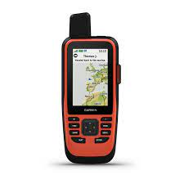
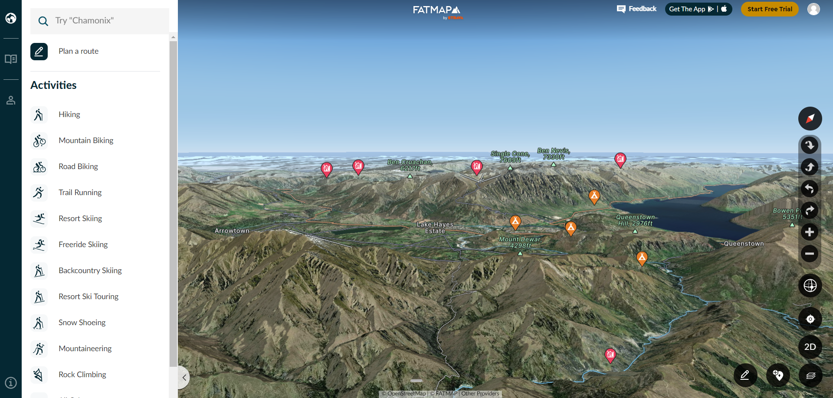
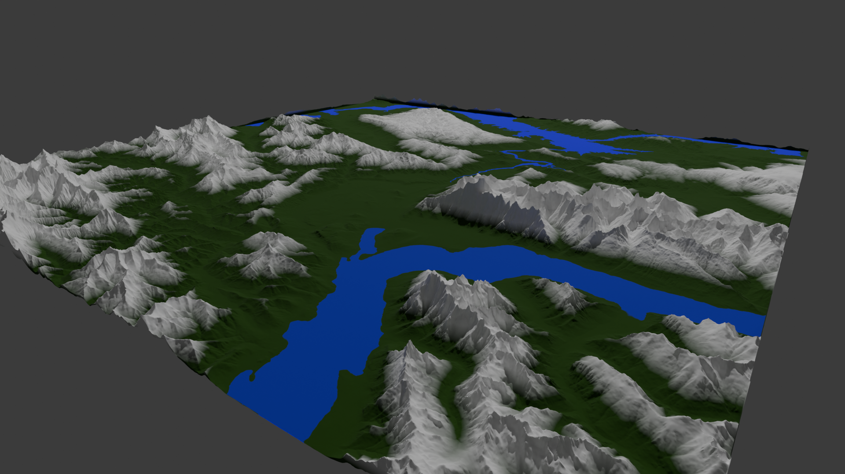
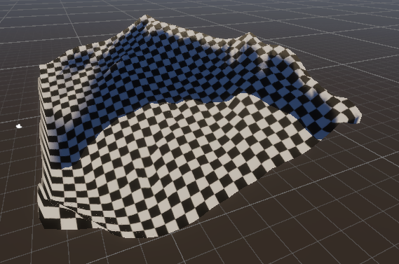
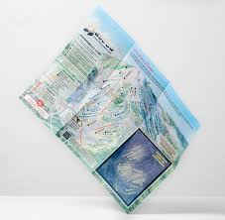
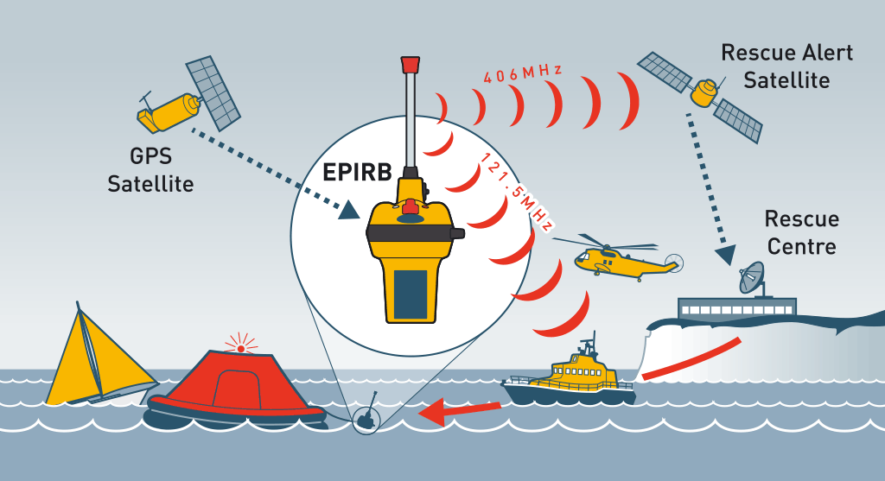
Existing Products and some conceptual ideas
This product is called FATMAPS. It gives a 3D view of terrain. My stakeholders have said that the 3d element is a positive from this product and I want to incorporate the 3d terrain into my design.
The tactile buttons on this GPS device are great as they can be used with gloves. It also reduces the cost, compared to a touchscreen or other more advanced input methods
EPIRB and other emergency locator beacons can be very useful if you are in an emergency, and you can’t reach search and rescue. Perhaps the design could be improved for the mountain environment, such as addressing avalanche risk.
When not in the Backcountry, Paper trail maps are the tried and tested form of navigation, but are very inconvenient to use, especially with gloves
These concepts are my first attempts at 3d models in and around Queenstown. The coloured image shows Lake Wakatipu and the Shotover Basin, with the Remarkables, Coronet Peak and Cardrona ski fields. The black and white image on the left shows my first experiments with the displacement texture, and it is a hill near Queenstown.
I will incorporate features from all of these products into my design, while hopefully I improve aspects of the design to fit my brief more, and make my product more fit for purpose. Mr Dymock has made it clear that I should separate my hardware and software in my conceptual design. Erik, a skier, loves the design aspects that I have selected, and encourages me to develop these aspects into concepts.
14

Slide 15
Initial Specification
Must run at a high speed and not lag
This allows the user to interact with the product without frustration. A low frame rate will be annoying for the user. Additionally, input lag and other performance issues could impact the ability for the device to be fit for purpose.
Must be easy to use, without bugs
If there are bugs in the software, it won’t work as intended. This could cause problems with the device, as unexpected behavior is confusing and frustrating for the user, and will reduce the devices potential to be fit for purpose.
Must not damage the environment
The device is designed to be used in mountain environments. A lot of these are conservation areas that have rules to protect the natural environment. If the device damages this environment, it is certainly not fit for purpose
Must keep user safe
The device is designed to improve safety in mountain areas. This means that it is important that the design actually does improve safety, rather than giving false information. Poor data will cause the device to not be fit for purpose
Must be able to be used in the backcountry (Offline)
The Backcountry is very dangerous, and therefore the product must be able to be used off the grid, to be effective in improving safety, and for the product to be fit for purpose
Must be lightweight and portable
If the design doesn’t consider portability and weight, the product will be annoying to use and unsafe. This means that the device won’t be used by skiers, and the design won’t be fit for purpose.
Must be use appropriate materials to survive very cold temperatures
The physical environment of the mountain and ski fields poses a unique challenge from the low temperature. This means all the components and materials must still work under these conditions for the design to be fit for purpose.
Must be able to withstand abuse from falls
As a skier, it is not rare for you to fall over, especially on steep runs. The device must be able to take a reasonable amount of abuse before breaking for the design to be fit for purpose.
Have a reasonable battery life
The battery life of the product must be reasonable, (More than 1 hour). This is so the battery doesn’t run out while the product is being used, which could be very dangerous.
15

Slide 16
Initial Specification - continued
Must run at a high speed and not lag
To achieve this, I will optimise the code if the performance isn’t good enough. This could mean reducing the quality of the models and graphics in the software, or using tricks to achieve the same result
Must be easy to use, without bugs
I will test the final design, and also get feedback from stakeholders to test my design, as they can give me feedback about whether they find it easy to use, or if they spot any bugs, and then I can fix them.
Must not damage the environment
I will only use materials that won’t significantly damage the environment, and will consider this when designing my product.
Must keep user safe
I will use high quality data, and this should help the user with navigation and helps keep them safe on the mountain.
Must be able to be used in the backcountry (Offline)
The data will be downloaded and packaged in the software, so internet access is not required.
Must be lightweight and portable
The design will be handheld and use lightweight materials, while still keeping structural integrity.
Must be use appropriate materials to survive very cold temperatures
I have done research on how cold temperatures affect the materials and electronics in the design, and they should be unaffected.
Must be able to withstand abuse from falls
I will make the casing reasonably tough and able to take hits, but it is important that this doesn’t increase the weight or size too much.
Have a reasonable battery life
I will use a large battery so there is little risk that the battery runs out. I will also try to figure out ways to reduce the power draw from the electronics to help with this.
Must be reasonably cheap
I will not have an infinite budget, so I must make sure that I spend money well.
16

Slide 17
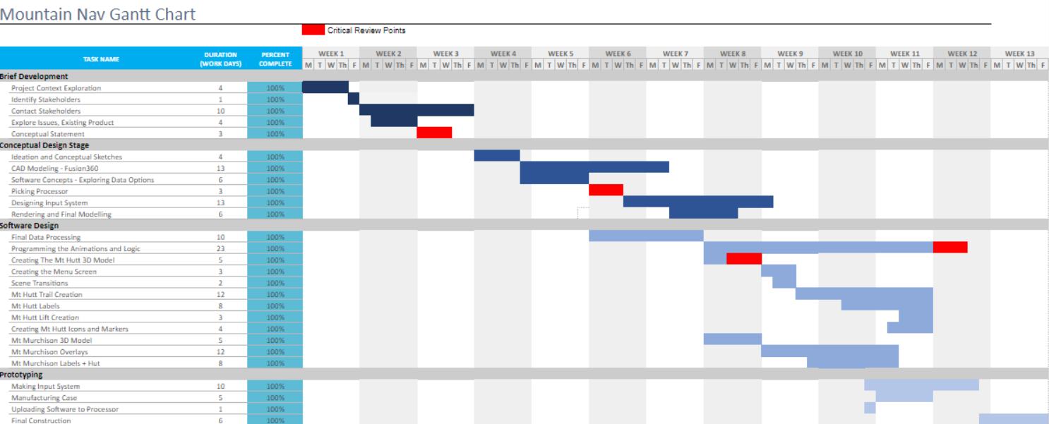
Gantt Chart - Planning
https://docs.google.com/spreadsheets/d/1et62oFYa2Mq1UEcdoXUSWQLu_qGlvqP4Eha4246mv0E/edit?usp=sharing
A Gantt Chart allows me to plan my time designing and making the product. This is important as it gives me a schedule to complete all of the tasks. I have added some “Critical Review Points” into the Gantt Chart as well, coloured in red. These points are important, as the project relies on these steps to be done right. These will be expanded on in the next page. At a critical review point, I will take extra care to get this step right, and spend time reviewing the progress of the project since the last critical review point. This Gantt Chart is from the end of the project. The Gantt Chart changed because the tasks changed over time, as the needs of the project changed my decisions about the design of the project.
17

Slide 18
Critical Review Points
Conceptual Statement
Picking Processor
The Conceptual Statement is a very important part of the project. This sets out the aim of the project, and is therefore a critical part of the project to get right. I have already done this step, and to make sure it is done right I made sure to engage with stakeholders with different backgrounds and get opinions of experts before writing my conceptual statement. This allowed me to identify a genuine need within the mountaineering community, and therefore more effectively assist them staying safe while exploring the mountains of New Zealand.
A big part of my project is how well it runs. This is clear in my specification, where I said the product must run smoothly. It is therefore crucial that I pick a processor that is capable of running the software necessary for the product to work well. To do this, I will pick multiple different processors to compare, and will pick the best one out of the group. Pure performance is not the only thing that matters, so does cost effectiveness and size. A better processor will make the device more convenient and less frustrating to use, and therefore help mountaineers more.
First 3D Mounain
Animations and Logic
The first 3D Mountain I create is very important. This is because this 3D model is a reference for navigation, and therefore has to be as accurate as possible. When I create the first 3D mountain, it therefore is crucial for me to make sure that the Data is not corrupted in any way, misinforming the user, and that the data is of a high enough resolution to be useful for navigation. I will do this by visually inspecting the model, and comparing it with imagery available of that place on google (or other sources). This will allow me to see if I can recognise the place from the map with the image, and tell me if my 3D model is fit for purpose.
The animations and logic of the software are incredibly important for my project. They dictate how the user navigates through the software, and it is important that it is an intuitive experience. To ensure this, I will make sure to consult with my stakeholders when making the animations, and allow them to test the software out. It is also important that the animations show all parts of the mountain, and the camera angles must be useful for navigation. I will design the animations to fit this criteria, allowing the final software to be useful for mountaineers, and easy for people to use intuitively.
18

Slide 19
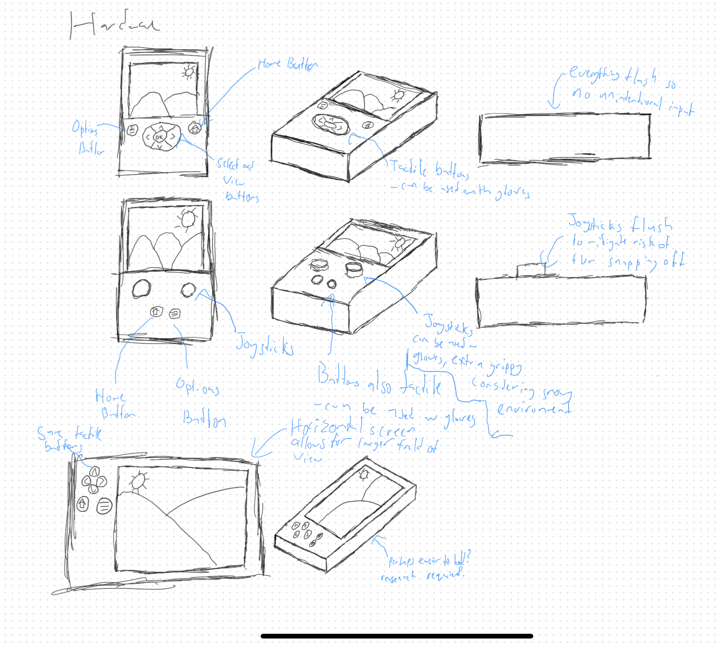
Concepts - Hardware
Stakeholder Feedback:
After contacting my stakeholders,
They wanted me to add grips to the device that will have sufficient friction in a mountain environment. This allows the user to have better grip, even if things get slippery. The stakeholders also liked the tactile buttons, as they could be used with gloves, so I will keep those in the next iterations. My stakeholders liked the layout of the first 2 concepts, so I will try to keep a similar design, although they said the screen was very small, so I will try to think of a way to increase the screen size. The stakeholders also thought the device was too bulky, so I will be looking to reduce the thickness of the device in the next iteration
Research:
I am fairly sure I want to make a handheld device for my product. This means for the next iteration of concepts I must do some research on handheld devices. To do this I looked at a report commissioned by the FAA^{[1]} about handheld device ergonomics. This helped me to design an ergonomic product, and my next steps are to start creating some models to test out the ergonomics and how it feels in the hand.
[1]https://hf.tc.faa.gov/publications/2005-human-factors-guidance-for-thev-use-of-handheld/full_text.pdf
19

Slide 20
Concepts - Software
Stakeholder Feedback:
My stakeholders said that they will want better zooming and camera control, as the view in the picture seemed too zoomed out and the current code for the camera is crappy. They also said that the accuracy of the map is essential. I need to make sure both the horizontal and vertical scales are correct, so the slopes have the right gradient. My stakeholders think that adding landmarks such as ski lifts, trails, restaurants, first aid and any other facilities is important. They also said that there should be live updates of lift status. Another suggestion was live traffic on the runs, but this seems quite hard to implement without a network of trackers, so this will be an idea for future development.
Future research and my ideas:
Avalanches are a big risk in the backcountry. This is why I need to research how to have avalanche guidance on the device that can advise the user on the avalanche risk level, and what types of avalanches may occur. This could be done using the already existing avalanche risk level, or I could create my own higher resolution algorithm. I think the avalanche system should also include an avalanche call for help system, that can be triggered in the moments before someone gets buried in an avalanche, and alert either nearby skiers or search and rescue.
20

Slide 21
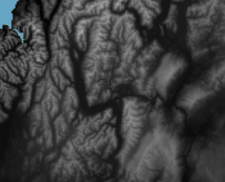

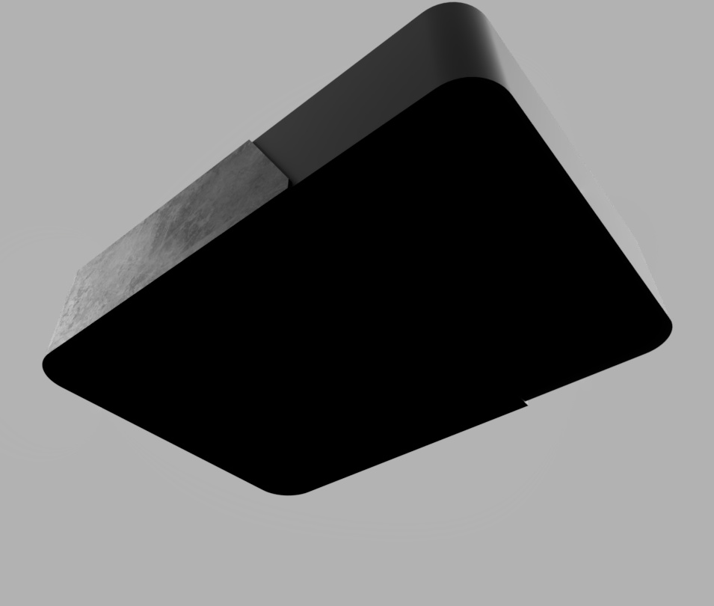
Beginning of Software development
Cad Models
Over the school holidays, I decided that I should work on the software. Working on the software now is important, as it can give me information on how to design the internals of the device. To create some of the models that have been shown as prototypes in previous slides, I used LINZ 10m resolution Digital Elevation Model. This provides me with Elevation Data I can use to create a mesh. To create the mesh, I used blender. First I created a grid with a lot of vertices, then I used a Displace modifier to move each vertex vertically to create a mesh of the terrain. This creates the 3d mesh of the terrain that I can texture. I used height to create the texture in my first prototypes. Will, a skier in my class said that a 3d map of the mountain is really helpful for navigating, as it gives better reference points, and is more similar to how we experience mountains in real life.
Next I want to create a prototype software, as the next part of the hardware design is for me to determine the Internal components of the device. This will be determined by the performance of whatever software I design, decided through testing of the application. I will try and make the design as cheap as possible while maintaining sufficient performance. This choice of hardware may also affect the size of the device, and I will have to consider this when designing the software.
10m DEM of Queenstown Area
I have used the stakeholder feedback to create a model of the hardware. I have added rubber to make the grip better for the mountain environment, and also create some curved edges that was a part of my stakeholder feedback.
21

Slide 22
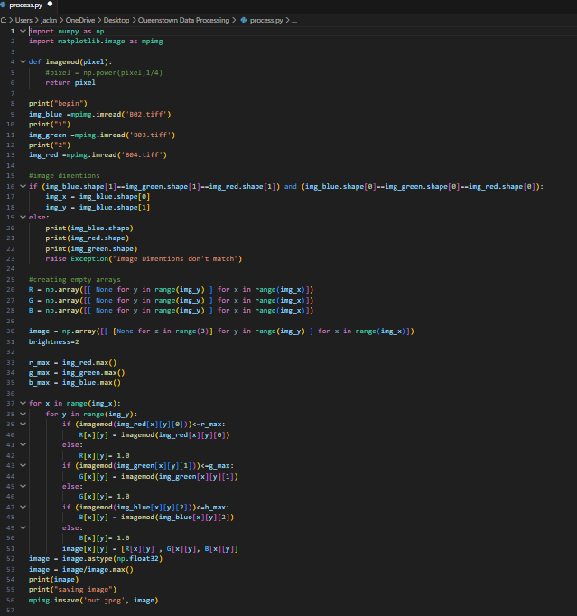
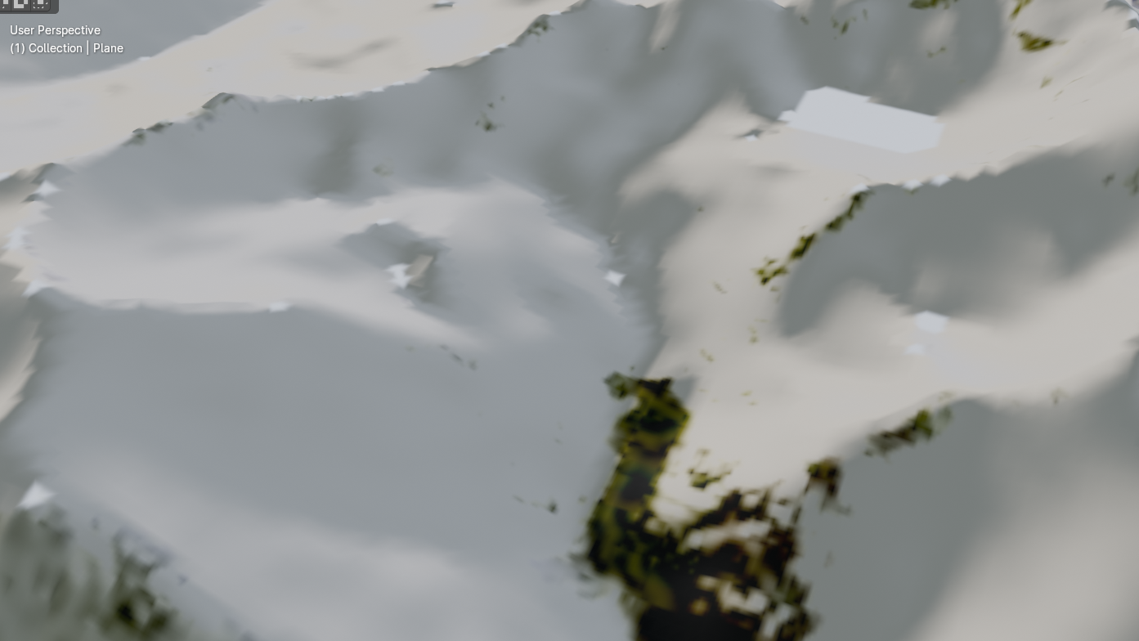
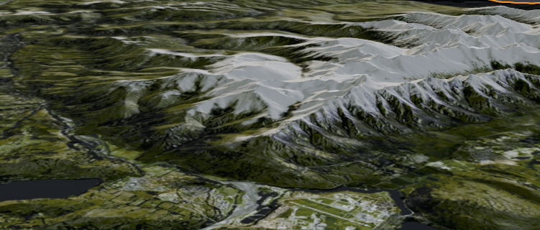
Creating Textures - Sentinel-2
Now I have a prototype mesh, I looked for satellite data to add to it. After some research, I found the highest resolution satellite data came from the Sentinel-2 Satellite. The resolution of this was 10m per pixel. I thought this would probably be sufficient for my project. I thought that this should be fine, and was the highest resolution that I could find. Unfortunately, unlike the DEM data, the Satellite data wasn’t ready to use right away. I had to process 3 black and white images, the red, green and blue bands, to create the full RGB texture. To do this, I created a small python script, and this created an output image that I could use to texture the model. The product of this was a really terrible low res version of the ski fields, a picture of the remarkables below. It was obvious an alternative approach is needed. Erik agrees, and also thinks that it is also not a very good picture of the ski field, and the quality of the product must be improved. He said that although the old map would be useful for navigating, an improvement is needed for a high quality product.
<- Remarkables ski field
-> Queenstown and Remarkables mountain range
22

Slide 23
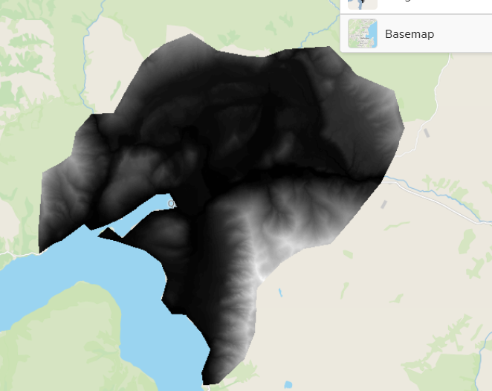
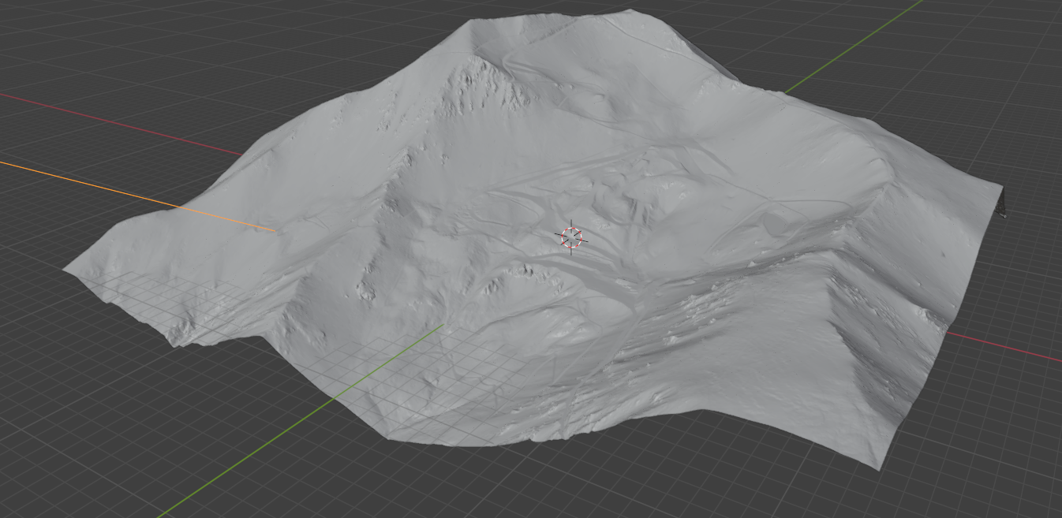

High Resolution DEM, and Satellite Troubles
To try and combat the terrible quality models, I decided to switch from the 8m Resolution DEM to 1m resolution DEM. The trade off of this is the 1m DEM has terrible coverage of the mountains, and It also means the meshes created with the method are very high resolution. The 1m DEM only has coverage of Mt Hutt, and most of the Remarkables, along with other mountains without ski fields. To use this data, I use QGIS to merge the DEM tiles together into 1 texture. For the Remarkables, I also am forced to use the 8m DEM for some of the texturing, as the very top of curvey basin is not covered by the 1m DEM. Using the same displace modifier in blender, I created the mesh, and it looked really good. At the same time, I spend a lot of time trying to get 1 m Resolution Satellite data alongside the 1m DEM, by putting requests into companies like Airbus and ESA to get satellite data of these places. I got no reply, so I decided that I needed another solution for the texturing of the mountain. Mr Dymock, My teacher and skier said the higher quality 3d map is great, as it gives a perspective on the steepness and technical difficulty of the terrain. This allows for more informed decisions when selecting runs. Cole, another skier said it was important to make the difficulty rating clear on the 3d Map, as it increases safety. LINZ Data, and therefore the high resolution DEM is available with a creative commons license. This means I can use it without worrying about copyright issues
1m DEM of The Remarkabbes
<- Mesh of Mt Hutt made from the 1m DEM.
23

Slide 24
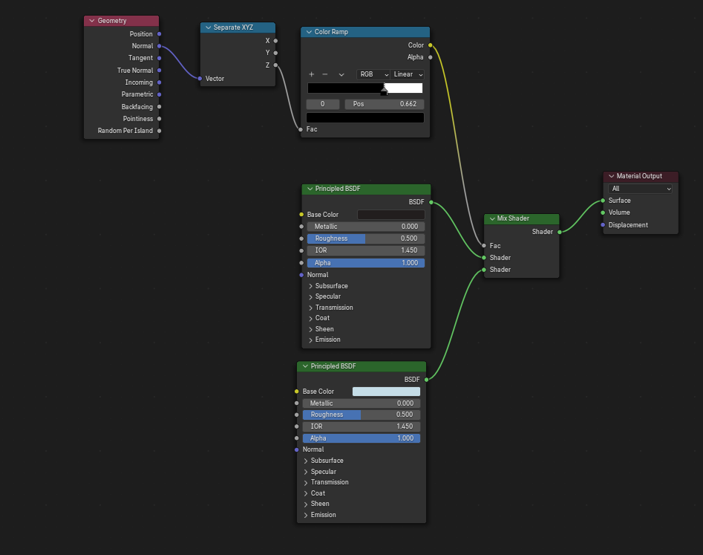
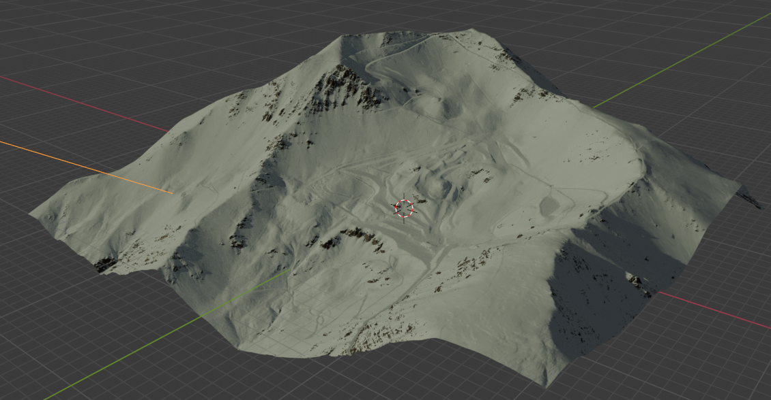
Texturing The High Resolution Model
To texture the high resolution model, I used Blenders node system to manually texture the models. I used the Normals of the geometry to texture the model. The normal of a model is a vector perpendicular to its surface. The smaller the Z (vertical) component of the normal is, the steeper the model is. This makes sense, as a flat plane will have a normal pointing straight up, with a maximum Z component, and a vertical wall will have a normal vector on the x-y plane, with a Z component of 0. By colouring steep areas, with smaller Z normals, a grey rocky colour, and flatter areas, with higher Z normals, a white snowy colour, I can create a good texture of the mountain. To do this, I used blenders node system to mix the rock and snow shaders based on the Z normal. The colour ramp node is meant to remap the normal values, and I adjected it until rocks where black and snow was white on the model. After baking this to an image texture, I used the Texture paint in Blender to perfect the texture, removing black from things that are human made, such as the edges of groomed trails. Erik and Will thought the textures looked really good and convincing. Mr Dymock and Erik thought that the textures were satellite imagery before I told him how I textured it, so I was quite pleased and obviously I did a good job with the adjustments, and this technique was clearly effective. Now I need to start work on the software to bring the model to life.
24

Slide 25
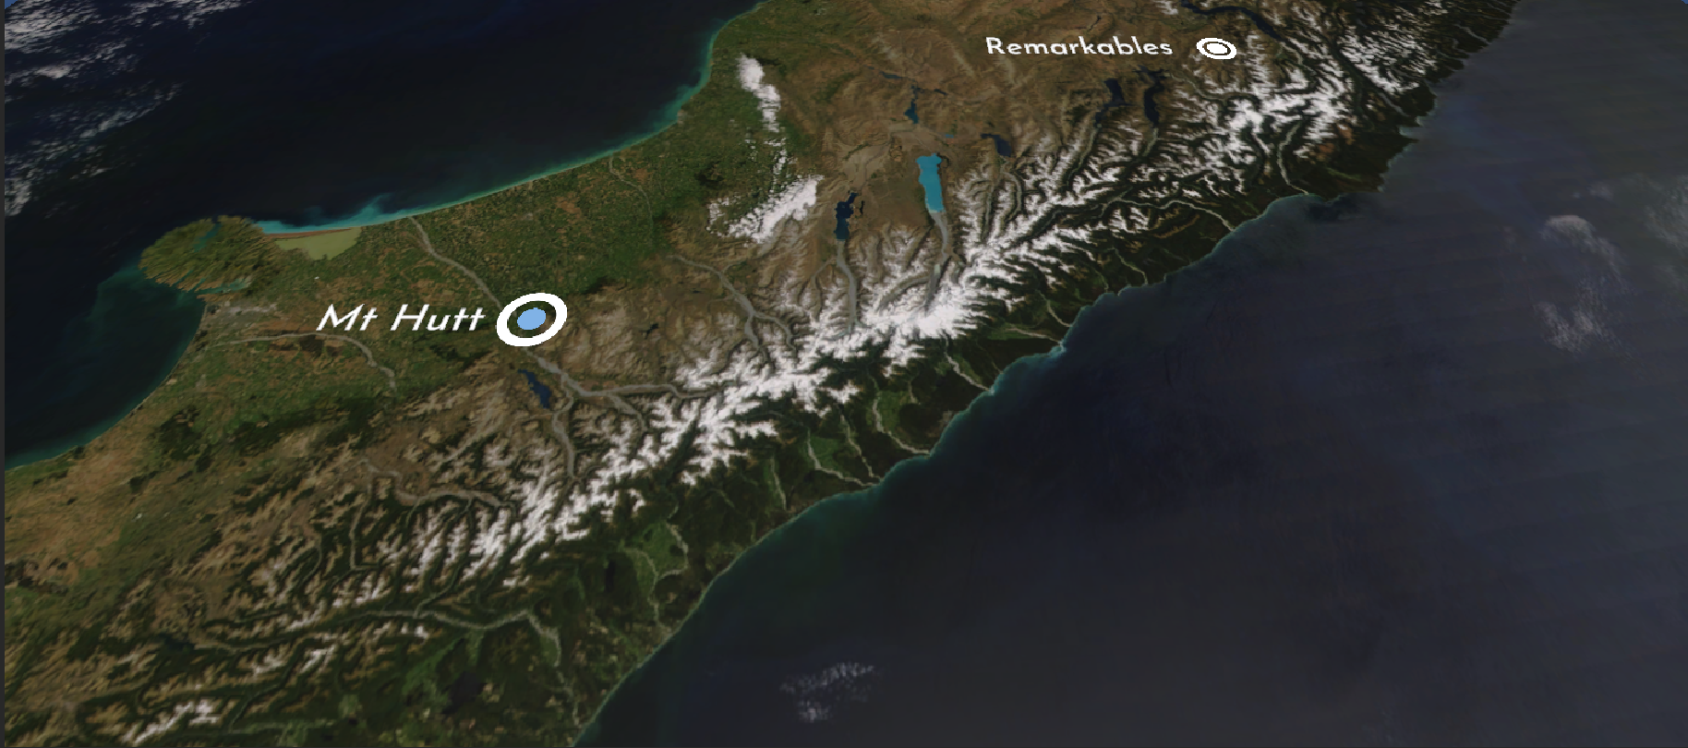
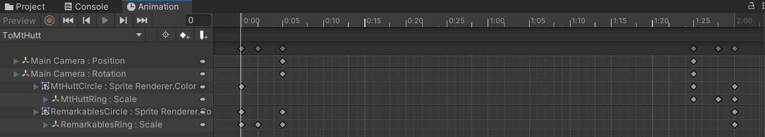
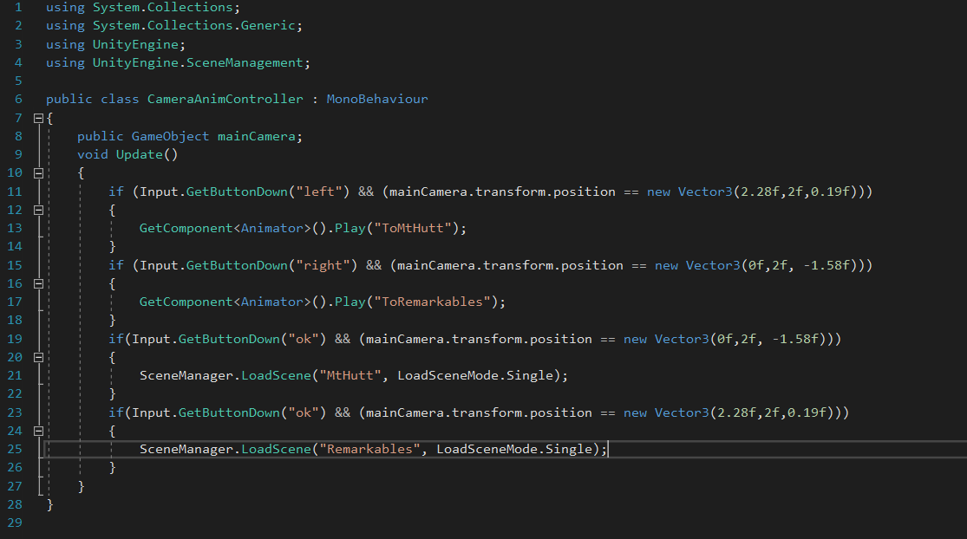
Creating the Map Menu
Video of animations on next slide
To select which Mountain you should go to, you need to select a Mountain from a list. Erik, one of my stakeholders and a potential user of the product suggested that I should use a map rather than a traditional menu. This allows a greater understanding of the mountains in the area, and in future, when more mountains are added allow people to find mountains near where they live or are staying. For now, I can only have Mt Hutt and The Remarkables because they are the only mountains with the 1m DEM data. This way of laying out the mountains also allows people to plan trips, as they know where all of the mountains are. To create this screen, I pulled a high resolution picture of the South Island from NASA, who processed MODIS data to create the image. MODIS is open data, and therefore is available for use in my project without copyright issues. I applied this as a texture to a plane, and put sprites over the plane for the label, and used a circle and a ring for the placemark. I animated these sprites and the camera using Unity’s inbuilt animation engine, and created 2 animations, one travelling from Mt Hutt to The Remarkables, and one from The Remarkables to Mt Hutt. I then created a small script to manage the animations, and pick which animation to play based on user inputs. I also used scripts to animate the text so it was always readable and facing towards the bottom of the screen. Animations seemed really cool to me, and Will, another stakeholder and potential user agreed saying the animations were really smooth and it improves the quality of the product.
Screenshot of Menu
Animation Dope Sheet
Text Animation Script ^
Animation Controller Code
25

Slide 26
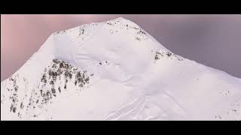
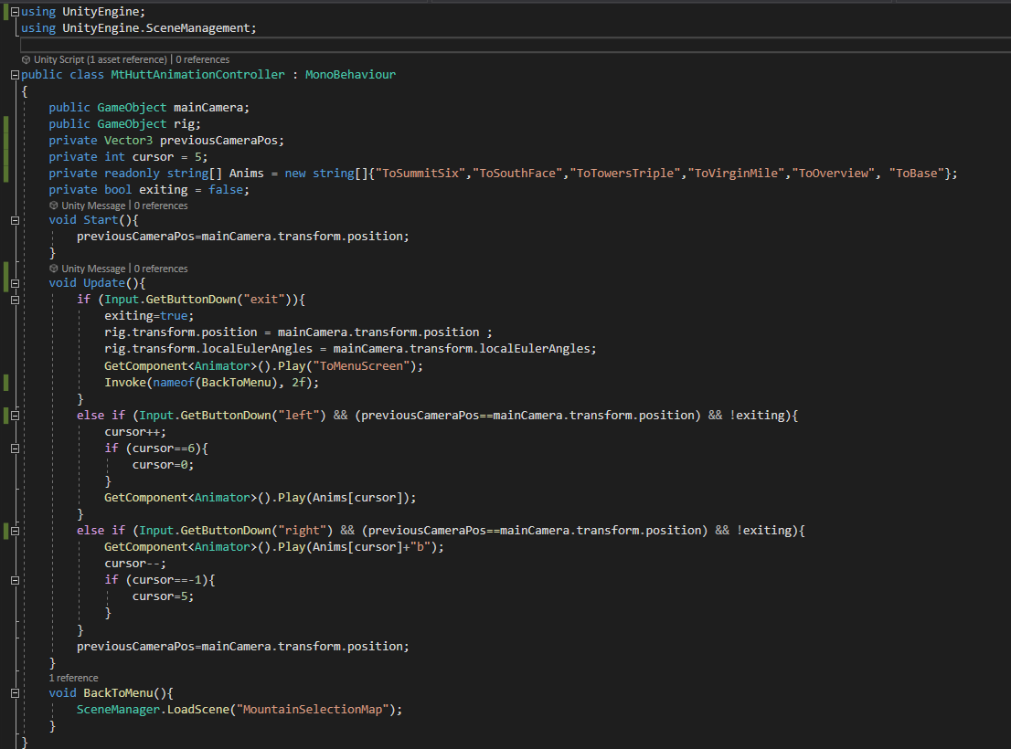
Animations and background
I imported my blender model into unity, and applied the image texture to the model. I then lit the model with 1 Directional sunlight, just like real mountains would be lit. I also added an HDRI Background, which can be seen in the video of the animations. The HDRI was from PolyHaven, by Sergej Madboroda. The image was released with a Creative Commons License, meaning I could use it in my project without copyright issues. This background just makes the whole scene come together, and the mountain seems in place. Erik says without a good background, the software would be clunky, and the mountain would seem out of place without a sky and with the default grey background. I also added Animations to the camera. This allows the user to navigate the mountain. I made it so you can cycle through the different ski zones with button presses. The video attached shows all of the zones. To go backwards, the animations are simply reversed. I created an animation controller script to manage the animations and trigger the correct animation for each keypress. This allows people to see each part of the mountain in detail. The animations mean that the terrain can more easily be viewed, and people can see what runs are near them. Additionally, I added an overview of the whole mountain. This allows the user to see all of the trails, and therefore have a better perspective of the whole mountain and how to get from one place to another.
Camera animations of Mt Hutt https://youtu.be/I27QIjw9Vgs
This script also manages screen wipe animations that are shown on the next slide
<- Animation Controller Script
26

Slide 27
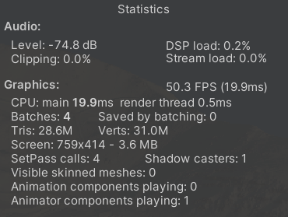
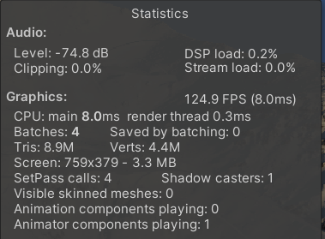
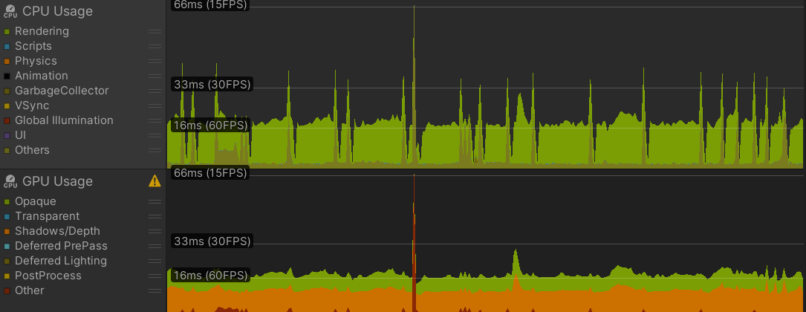
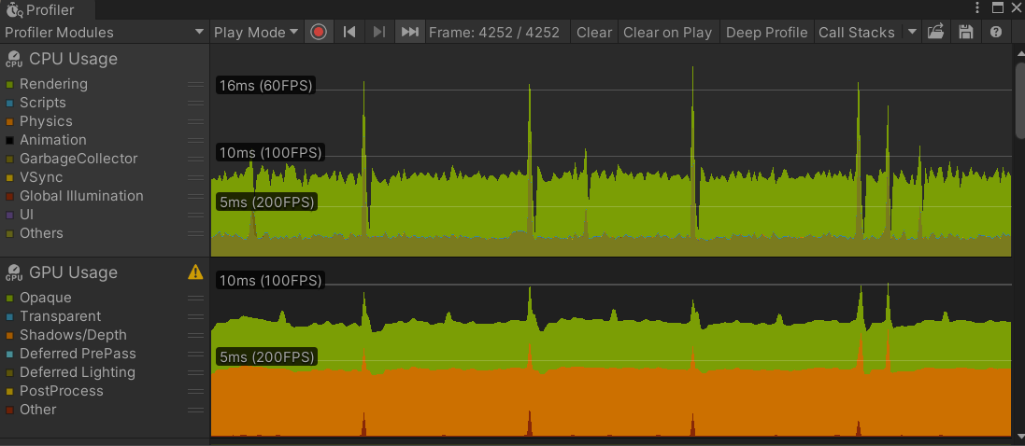
Performance Optimization - Vertex Reduction
The performance of the software was not at an acceptable level, especially since the software will be running on way worse hardware when the device is built. All of my stakeholders have said that the software running smoothly is very important, and I will need to improve this area. For better performance, the mesh needs to reduce in vertex count. To do this, I went back in to blender and used the decimate modifier. This deletes vertices that are not contributing much to the mesh detail, as the angle of the edges is close to 180 degrees. This reduced the vertex count heaps. Additionally, I used a triangulate modifier to convert the mesh back into triangles, as n-gons don't render properly in unity, and triangles work better on the GPU. I tested the game before and after making these changes, and the FPS more than doubled, and both the CPU and GPU are taking less processing time due to the changes.
Before Mesh Improvements
Low FPS
High CPU and GPU Rendering Load
After Mesh Improvements
Improved FPS
Lower CPU and GPU Rendering Load
Profiler Notes: Y axis is frame time, X axis is frame number.
The y axis is scaled differently in the two profiler screenshots
The Spikes are due to the GPU drawing the profiler, not my software
27

Slide 28

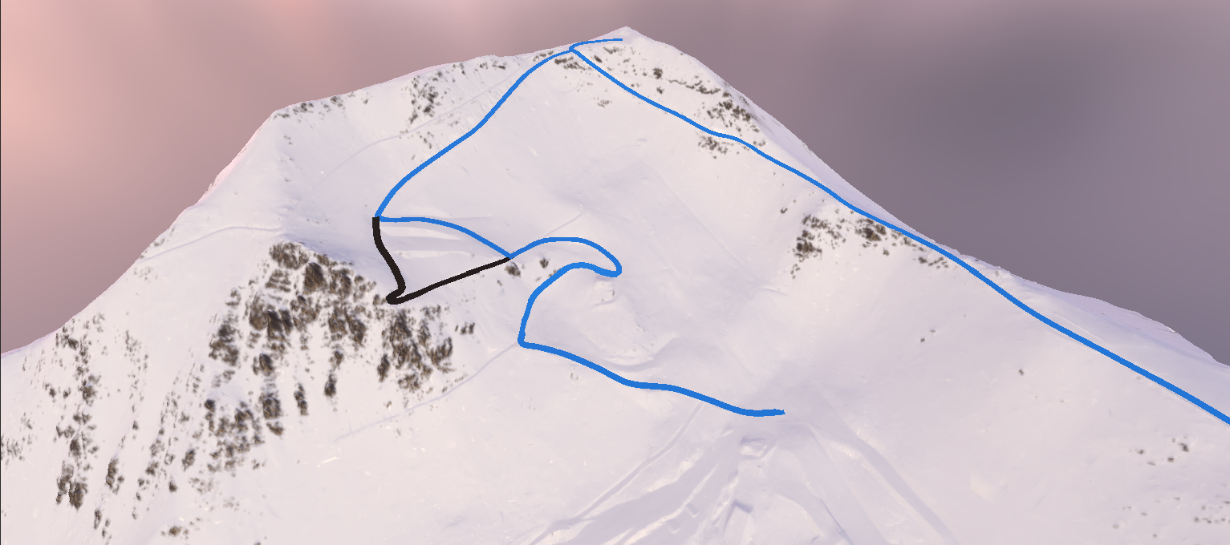
Adding Transitions, Trail Creation and Lifts
I am starting to add the trails, lifts and labels for other facilities into the software. This is a long and frankly boring process, where I have to plot a bezier curve for the trails, and I had to do some coding for the Lifts. To create the trails, I used Sebastian Lague’s Path Creator tool. This allowed me to create bezier paths in the unity editor, and also had a script included that constructed a mesh around the paths, that I would use to create the Trails. I plan to add labels to the paths once I have finished everything. Additionally, I plan to use sprite textures to signify important locations, such as the medical office, Ski Patrol’s base and also things like cafes, toilets etc. This would give a better experience, as people can better navigate with these landmarks. To create the lifts, I also used the Path Creator Tool. I used the tool to create the lines, and made little cuboid chairs with a path follower script. Although the path creator tool included a path follower script, I had to modify it so I could simulate the little chairs going up the lift. Finally I added transitions too and from the menu screen, as seen in the video. This allowed the app to feel more cohesive, and it also stopped the jarring effect of snapping into the next scene. A movie of the lift is on the next slide, as there is no space here. I showed these to my stakeholder Will, and he really liked it. He said the trails looked very similar to paper trail maps, but the depth from the 3D models meant he thought it would be easier to navigate. He also said the screen wipe animations looked really clean, and gave the software a professional feel.
Screen Wiper Animations https://youtu.be/Apy4r-qtQTQ
Examples of some trails
28

Slide 29
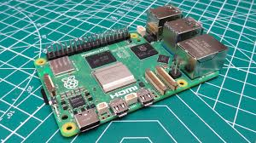
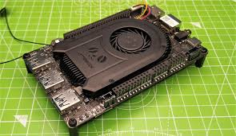

Choosing Hardware, comparing SBC’s
After Analysis of the software, it is clear that the bottleneck is the GPU, due to the high vertex count. The CPU spent around 40% of its time waiting for the GPU to complete the frame.
Raspberry Pi 5
LattePanda 3 Delta
Orange Pi 5 Pro
MIPI Display
2.4GHz Quad Core CPU
4-8GB RAM
GPU - VideoCore 7
Short & doesn’t include Arduino Chip
Linux
$90USD
eDP Display
2.9GHz Quad Core CPU
8GB RAM
GPU - Intel UHD Jasper Lake 24EU
Short & Includes Arduino Chip
Windows and Linux
$239USD
MIPI Display
2.4 GHz Eight Core CPU
4-16GB RAM
GPU - ARM Mali-G610 MP4
Tall & doesn’t include Arduino Chip
Linux
$141USD
I think the Orange Pi 5 Pro is the best option. This is because MIPI displays are the most available displays, making the MIPI port on the Orange Pi 5 Pro desirable. The Orange Pi 5 Pro has 8 cores, where the others have 2. The Raspberry Pi 5 has a bad GPU, and the other 2 have mid range GPUs. This is a deal breaker, and I can't consider the Raspberry Pi, even though it has the best price. The Latte Panda 3 delta is quite expensive, for not much more performance, therefore I picked the Orange Pi 5 Pro.
29

Slide 30


More Performance Optimisations
I borrowed a Raspberry Pi for testing, and the performance was terrible. It was clear that further optimizations need to be made. To do this I pre baked the lighting of the scene. To do this I went into blender and changed some settings for the texture bake to include the lighting in blender. This allows me to use the unlit shader for the mountains material, and this means the GPU doesn’t have to do any lighting calculations. This increased my frame rate, as the GPU didn’t have to perform all of the expensive lighting calculations. To stop the already lit texture having lighting applied to it, I used the “Unlit” Shader rather than the “Standard” Shader. Both are inbuilt into unity. I can do this as there is no dynamic lighting in the scene, so the way the object is lit does not change. Additionally, everything else on the map doesn’t really need lighting, so I also used the unlit shader, and removed the lighting elements in the scene (Other than the Sky, which is used to light the lift boxes). This should improve the framerate of the game. Additionally I gave all of the non moving game objects the static tag. This tells unity that the objects don’t move, and therefore unity doesn’t waste time calculating its movement. This also increases performance and increases frame rate
CPU Profile. Most of the frame time for the CPU is wasted, waiting for the GPU to process all of the vertices (See Below). The code on the GPU must be optimised.
Video Of the lifts animated.
Note :Towers triple chair (Lower left corner) travels slower as it is slower in real life.
https://youtu.be/AINx-uiXTgo
30

Slide 31



Material Choices Evaluations - Case
Plastic
Aluminium
Wood
Plastic is made up of polymers, long chained molecules. Plastic is relatively Malleable, especially at high temps. This allows it to be easily moulded into different shapes, using various techniques. Plastic is very lightweight, and has a relatively high strength to weight ratio. Plastics can also survive the alpine environment very well without degrading. Plastics can have a negative environmental impact, taking lots of time to biodegrade. Plastic is cheap and can be made into different colours.
Aluminium is a metal, made up of individual Al atoms. Aluminium is also malleable, but requires very high temperatures. This means it cannot be moulded, rather it must be cut. Aluminium has a low density and a relatively high strength. Aluminium can survive cold temperatures and the alpine environment very well. Aluminium cannot be coloured, and also takes lots of time to degrade. It is quite expensive, and it is not aesthetically pleasing at all.
Wood is a complex material made up of dead trees. Wood is not malleable at all, and must be cut to shape it. Wood is lightweight and relatively strong. Wood has a high resistance to temperature changes, however it requires treatment to be able to survive the alpine environment. Wood can be painted, but it is likely the harsh alpine environment will strip this paint off. Wood can biodegrade easily, but the treatment could cause harmful chemicals to leach into the soil.
In the end, I felt plastic best fit my brief, because It was suitable for the physical environment, and it is easy to manufacture plastic parts, due to the high malleability. It is lightweight but still strong, while also being cheap. Although plastic can have a negative environmental impact, as long as the plastic is not left in the environment it is fine.
31

Slide 32
Manufacturing Methods Evaluation (Plastic) - Case
3D Printing - Resin (SLA)
3D Printing - SLS
3D Printing - FDM
Injection Moulding
Stereolithography (SLA) 3D printing involves exposing a vat of resin to light, curing the resin in layers. The Light is aimed such that the resin cures in a shape that is given by the design. Overhangs can be created on SLA 3D Printing. We don’t have an SLA 3D printer at school, and I would have to get the part manufactured externally. SLA has a really good surface finish (No layer lines) and has the same strength in all directions, a property called anisotropy.
SLS 3d printing (Selective laser sintering) is a manufacturing process involving lasers melting layers of plastic. As the laser is shined onto plastic powder, it melts forming a solid. By controlling what parts of the powder melt, you can create a custom 3D Solid shape. You can create overhangs with this technology, as everything is buried in powder. Nylon is used as the main material for SLS 3d Printing. This is often used in winter jackets, and is appropriate for the outdoors.
FDM 3d printing (Fusion deposition modelling) is a manufacturing process where layers of material are extruded onto a print bed, slowly forming a 3D Shape. We have a FDM 3D Printer at school, meaning it is very easy for me to access this technology. The Plastics available to use for printing are PLA and ABS. Both of these materials are appropriate for the physical environment, as discussed on slide 9. Unfortunately FDM cannot create steep overhangs, because the melted filament falls.
Injection Moulding is a form of manufacturing where molten plastic is injected into a mould, and cools to form the shape of the mould. This process requires the use of expensive moulds and tooling. If I was going to mass produce the part, I would have explored this method of manufacture further but I found the cost is prohibitively expensive to manufacture a prototype. Because the cost of manufacture is mostly in reusable tooling, the impact of this is reduced when many units are produced.
In the end, I felt PLA plastic FDM 3d printing was the best option because of how accessible this manufacturing technology is to me. I am able to use the FDM printer and filament at school, and I also have access to software that allows me to use the printers with ease. PLA is an appropriate material for the physical environment, and the structure should be strong enough for a medium strength impact. Snow provides cushioning, so this should be sufficient. I will have to be aware and create a design with no overhangs
32

Slide 33




First Prototype, Testing and improving the case
After printing a prototype of the case, I noticed that the lid was bowing a bit, as seen in the top image. To fix this, I printed a thicker version of the lid, seen in the below image. This was suggested by Mr Dymock, one of my stakeholders. He said that this would fix the problem, and give the lid some stability. I also noticed that the layer on the print bed has a more grippy texture. This is why I flipped the lid on the print bed for my second print, as it gave the top slightly more grip, which will be beneficial in slippery and wet environments. I also added the holes for the screen and the buttons in the second design. I think that the new design is better than the old, as there is better structural stability and better grip in the new design. I also changed the layout of the screen and buttons, for the next prototype, and this will be discussed on the next page.
The Printer failed and stopped printing the bottom part of the case halfway through, that is why it is so short
33

Slide 34


Redesigning the case.
Having looked at the available LCD screens, my software, and the dimensions of the Orange Pi, I decided that I needed to change the design. Mountains are best presented in landscape (hence the name), but my old design used a portrait screen. A landscape screen is therefore more fit for purpose, so I needed to redesign. Additionally, portrait screens aren’t readily available on the market for the sizes that I wanted. I printed out a model of the case (This had issues addressed in the next slide) to hold it, and get a better idea of the ergonomics of the landscape version. I noticed that with a landscape case, it felt quite comfy when held with 2 hands rather than 1. The thumb wraps around the short edge nicely, making pressing the buttons easy. I thought the shape of the case was really nice to hold. I gave a prototype case to some of my stakeholders, to get stakeholder feedback on the ergonomics. Erik said it was nice to hold and felt very comfortable in the hand. He thought that the case did feel delicate, but I did some drop tests on it, and after showing him the drop tests, they changed his mind.
Another addition to the revised case model is air vents. Air vents allow air flow into the system. As the intended environment for this device is the mountains, this air should be really cold. The air vents are placed such that this cold air flows through the middle and, where I am planning on mounting the Orange Pi and Battery. The Orange Pi is the main component that needs to be cooled, as it is where the Mountain Model is processed, and this takes the most computing power. The revised design also includes slots for the buttons, the source of user input. The buttons will be designed at a later stage. One of my stakeholders, Erik said that it was important to try to keep the CPU cool. If the processor gets to hot, it can shut down, and this could be dangerous if you are relying on it for navigation. The air vents mean that hot air won’t be trapped in the case, rather getting constantly replaced by cool mountain air, meaning heat shouldn’t be an issue
34

Slide 35





Input system
I needed a way for the buttons to interface with the Keyboard. To do this, I used an Arduino Pro Micro, from Sparkfun. This board contains the ATMEGA32U4, rather than the ATMEGA328P from the Arduino Nano, the board we had on hand. This is because the 32U4 is capable of using its USB port as an HID device. This means that I can make the computer think the Pro Micro is a Keyboard, and then send keypresses to the Orange Pi. This then can interface with the Unity program, to run the software. To do this, I had to create a circuit, connecting the Pro Mini’s convenient Digital I/O pins to buttons, with Pull Down resistors to connect the buttons with the Pro Mini. This is seen in the schematic. I then designed the board using Eagle Cad. I placed the components on the board, and made sure the buttons lined up with the holes on the 3d printed lid. I used the Auto Router with a minimum trace width of 70 mil (0.07in). This was set so high, as the vinyl etching process and drilling may have a little imprecision, so thick traces ensure good electrical contact with this imprecision. The Vinyl etching process was great as it allowed me to make Copper Boards which we had on hand to a custom circuit board. To do this, I put green vinyl on the copper board in the pattern of the traces that I wanted. This can be seen in one of the images. I then put the copper board into a 1.8molL⁻¹ FeCl₃ solution. The copper not covered by the vinyl got oxidised by the iron(III) in the equation 2FeCl₃ + Cu → CuCl₂ +2FeCl₂. The Cu gets converted into soluble Copper(II) ions, while the copper under the vinyl remains, creating the circuit board.
^PCB Traces from Eagle (Top)
Arduino Pro Micro (Bottom)
^PCB Traces from Eagle (Top)
PCB Schematic From Eagle (Bottom)
35

Slide 36



Input system
The software for the input system is pretty simple. The Library “Keyboard.h” does most of the hard work for me, by allowing me to write to the USB port with keyboard instructions. I use the buttons on the board to trigger keypresses. This means the buttons act as a keyboard, that controls the computer, and allows the software on the Orange Pi to interface with the user. The next step for this part of the design is to work on button caps, and on how I will mount the board into the case. I have added holes for this purpose. One of my stakeholders, Mr Dymock said it is really important for the buttons to be tactile, and able to be used by a gloved hand. This is why I am using this approach for input.
36

Slide 37



Further Refinement and Prototyping of the Case
After the case redesign, I realised I forgot to add holes for charging and an on/off switch. My old design had the battery above the computer, but my new design had the battery at the bottom. This was because the Orange Pi was way smaller than the battery, so it made sense for it to be smaller, and having the charging port and on/off switch at the bottom helped with drainage, as any water will drain to the bottom of the device. I also had to increase the size of the case. This was due to me not being able to fit everything in the original case size. In future, I would try to reduce the size for ergonomics, but considering the budget I have, I can’t create a custom computer board and design an ultra thin battery. This is an unfortunate reality, but could be considered a main design goal for future development. I made some slight modifications to the case as well. This includes adding a ridge to the case lid for the screen to fit in, as suggested by my stakeholder, Mr Dymock. This worked really well, and I could add glue to secure the screen into the case. Additionally, I added ridges for the Battery, to secure it into the device. I also added counterbored screw holes, suggested as well by Mr Dymock. This makes the screws flush with the case lid, improving the aesthetics.I also decided on the final colour, red. This was so the device can stand out in the snow if lost. That is important because if a crash occurs, you want to be able to locate the device easily. I 3D-Printed the prototype and gave it to some stakeholders to gather feedback.Erik said it feels good in the hands, and was easy to hold. Mr Dymock said it was grippy, which was good to hear as obviously my grip pattern was working. It also was easy to hold with gloves, according to Mr Dymock, we tried holding it with welding gloves to replicate ski gloves. Mr Dymock said that the button size could be increased to make it easier to use. This could be an Idea for future development
37

Slide 38





Button caps and decals, and colour selection
Colour selection.
I talked with one of my stakeholders, Erik, about the colour of the case. Although we both agreed a neutral colour would be the most aesthetic, he suggested that as it is a safety device to be used in extreme environments, a more visable colour could be more appropriate. I agreed, and we thought that Red would be an appropriate colour. Red is very visible in the snowy mountain environment that the device would be used in. In the event of an avalanche or a wipeout, the case would be visible if it wasn’t buried. However, If I was to bring the device to market, I would create a range of colours the user can select from. The more neutral aesthetic colour schemes may attract a more casual market that isn’t going to take much risks, and the extra safety feature of the bright colour is unnecessary. I would also have a bright red model for more serious skiers.
Button Caps and Decals.
I designed 4 little button caps. These were fairly simple to design, and I could just make them fit the holes on my case. I added a little tolerance for the button caps to slip through the gap, and I also added chamfers to the buttons as it made it blend into the case better aesthetically. I used some graphics from a set of SVG’s, namely the lineal interface collection. I liked how simple they looked, and how well the set fit together. There was also 4 appropriate images for the buttons I wanted, so I was really pleased with this choice. Cole, one of my stakeholders said that the buttons look nice on the button caps. He thinks that the chamfers look really good and they make the design look clean and inviting to press. He also thinks they are simple and self explanatory.
https://www.svgrepo.com/collection/lineal-interface/
(Open Licence)
38

Slide 39




Final Renders of Design, Analysis against Brief
My Final Design meets the brief I set out at the start of the project relatively well. I feel that the design meets the needs of people on ski fields to navigate the mountain environment. At the moment, I unfortunately don’t have any backcountry. Unfortunately my product doesn’t have GPS capabilities, as I have ran out of time to add this. However, the product does give trail names and landmarks, which could be useful when contacting Ski Patrol. GPS and Search and rescue capabilities are areas for future development. It also helps people take the right runs, and not end up trapped above runs that are more difficult than their skill level. The design is robust, and is appropriate for the mountain environment. However, it is quite bulky and heavy, due to the large amount of hardware and cables inside. This is another area for future development, potentially having all the components on the same board to save space. In conclusion, although all of my original specifications where not met, I still think that my design fits the brief to a satisfactory level, especially for a prototype that could be developed more in the future.
39

Slide 40





Thermal Management of the CPU
Unfortunately, when the OrangePi and heatsink arrived, I realised that the heatsink didn’t fit the motherboard, and only fit the OrangePi 5 Plus, rather than the Pro. I needed to fix this, so I discussed options with one of my stakeholders with expertise in manufacturing, Mr Dymock. We decided to cut down the existing heatsink and attach to the Orange Pi we had with a hook. Firstly, we cut down a row of the fins, with a hacksaw. This was very convenient as it was just the right width to make it fit. After this we had to use the mill to machine the other side down. This was more challenging, and the spinning of the milling drill bit caused the small fins to bend, as seen in the image. We wanted to keep as much of the heatsink as possible, to maximise the surface area of the heatsink. A large heatsink surface area improves thermal performance, and both me and Mr Dymock agreed that this was important. To fix the wonky heatsink, we used a scribe to push the fins back into place. This was for aesthetic purposes. To attach the heatsink, I used one of the already existing pins, and a hook. We had to cut off the other pin to make the heatsink fit. I designed the hook to attach to one of the holes on the PCB, which was the most secure mounting point. The hook was designed to be strong so it wouldn’t snap, and also was slightly shorter than the heat sink. This meant that it was springy and pushed down with some force on the Heat sink. This ensured that there was good thermal conductivity between the conductive pad, the processor and the heatsink, improving the thermal performance of the CPU.
40

Slide 41

A working prototype and Droid Manager
I used an Android OS for the device. This was an easy decision to make, as of all the OS options given by the manufacturers of the Orange Pi, Android was the only one that unity would build for. First, I had to install Android onto the OrangePi. To do this, I followed the instructions on the user guide for installing Android. I first tried to use the SD Disk Tool software provided by the OrangePi Manufacturer, but this didn’t work. The user guide provided an alternate solution, a software called RKDevTool that could be used to burn the software on the microSD card. I had to put the microSD card in the OrangePi, and connect it to my computer through USB. This worked perfectly, and android booted with no errors. Next, I had to build the android app using Unity. Unity required me to install various developer tools (Android SDK, Android NDK and Open JDK) to complete the build, however the documentation about the versions was very poor. After hours of error messages and uninstalling and reinstalling different versions of these tools in android studio, I finally found a combination that produced a successful build. I moved the APK file produced to the OrangePi using a USB stick, and installed the App. This worked perfectly, and you can see the result in the photo. The frame rate was 29FPS, but I will do a deeper analysis of the performance on the OrangePi once I finished the software. As there are only 4 buttons on the final case, I had to make the software run right after the OrangePi booted up. To do this, I used an app called Droid Manager. After installing the APK using the USB, I set it up to run my app at boot. This worked perfectly, and I was ready to continue work on the software.
41

Slide 42


Text Design - Concepts
MT HUTT FONT
Text Design
I now started working on the rest of the software. The next thing I decided to do was the text for runs and other notes on the map. To start on this, I made some concepts of text design. For each concept I came up with, I wrote some notes about the different texts below their sketches. I got some stakeholder feedback on the design of the text. One of my Stakeholders, Erik says that on a 3D map, 3D text is the obvious choice. He said that the 3D text popped, and made the text feel integrated into the 3D environment. He also said that the White outline of option 4 and 2 was really cool, as it highlighted the text. He said the 2D options looked flat and boring. He only liked option 4, and this is therefore the option I will pursue.
Font
I wanted a font similar to or the same as the font of the trail map that NZSki uses, for Mt Hutt. I had to use AI to search the Internet for fonts using a screenshot of the text from the trail map, and after a while, I found the Montserrat font. This font looked exactly like the font on the trail maps, and I really liked it’s sleek bold design. I decided to use extra bold weighting, as after discussing with Erik, we agreed this weighting was the best for readability and emphasis on the trail names. Readability is really important, as if the font is difficult to decipher, it will be irritating for the user. Additionally, we thought that the font couldn’t look old, and therefore a sans serif font such as Montserrat was appropriate. For these reasons, I decided to use Montserrat with extra bold weighting.
Font Source
https://fonts.google.com/specimen/Montserrat (Extra Bold Weight)
42

Slide 43




Text Design - Final Design + Animation Changes
To create the text, I had to use blender and import individual 3D models into Unity, as Unity didn’t support 3D text. Blender had a 3D text creator that I could use. Each text had 0.25m of depth and a 0.05m round bevel. After converting the text to a mesh, and Unwrapping the UV information, I used a similar technique to texturing the mountains to apply the colours. Only the flat parts were coloured, and the bevels and edges are white. This led to the texture I wanted. Using this technique saved me from having to manually texture each 3D model, and this saved me hours of time. After that I imported the text into Unity, and I placed each name into an appropriate location. I scaled up the text for the main runs for readability. After showing the results to both Erik and Will, my stakeholders, they both thought that I needed to move the camera closer to increase readability. I agreed that this issue was major on the smaller screen. After tweaking some parts of the animations, I found a point where I was happy with the readability of the names. An idea for future development is an accessibility setting to scale up the text for people that had poor eyesight.
43

Slide 44




Graphics - First Aid and Other Landmarks
As Identified during the brief development consultation with stakeholders, it was clear that Landmarks were important for ski fields. On Mt Hutt, the only landmark was the base buildings. To create these Icons, I used Blender. I used a similar process with the text creation, but I used emojis instead of normal text. This yielded the 3d Models for the Icons. To texture them, I had to generate the UVs, and I hand painted the textures using Blenders Texture painter tool. This yielded the top Icons. After stakeholder consultation, It was clear from their feedback that the images lacked contrast around the edges due to me using an Unlit texture (An optimization discussed above). To fix this, I suggested using Borders to highlight the edges of the design. To do this, All I had to do was redo the whole process. I adjusted the UVs to make the design look better, as if I didn’t change them, the edges would look pixelated. The results looked really good. I didn’t add a border to the off piste black diamond icons, as they already looked really good, and didn’t need a border. I also made some minor adjustments to other details. This includes replacing the loading screen font with Montserrat, in a similar style to the Trail Names. This looked way better, and gave the app a theme throughout the various screens. Similarly, I replaced the map labels with new 3D text, with the Montserrat Font. This, for similar reasons looked way better. At this point, Mt Hutt was finished, and I needed to begin on the next mountain. As the Remarkables data was incomplete, I decided to use a ski area in the backcountry instead. This will also give me the opportunity to create some features to improve safety in the backcountry.
44

Slide 45




Backcountry - Importing Mt Murchison.
The original plan was to add the Remarkables, with some low res data. Upon review, I realized that this plan didn’t fit the needs of mountaineers and backcountry skiers, and didn’t give them any tools to keep them safe. Additionally, I had no tools to help with avalanche safety, and also to help navigate backcountry terrain. After reviewing the stakeholder feedback, and my brief development at the start of the project, it was clear that I had to change tack on the direction of my project. This led me to change from the Remarkables to Mt Murchison, A mountain in the shaler range with a mountaineering hut (Baker hut) and is a backcountry skiing location. I picked this mountain, because it had a hut in the area, high quality DEM data from LINZ and was a good area for backcountry skiing. I also included the Mt Murchison peak, as mountaineers may be attracted to the summit. Implementing this involved a very similar process to Mt Hutt, and I therefore I used the same processes. Obviously there was no trails, so I didn’t make trail markers, and instead of labelling trail names, I labelled Landmarks. This would be useful for navigation, as when navigating landmarks are useful for orientation. I additionally added spot heights, as these are useful in order to gauge elevation, using the same labels. An Idea I had was data to help skiers and mountaineers to judge avalanche risk. I created Blender node systems to measure Slope Aspect, Elevation, Slope Angle and Avalanche Danger. Some of these can be seen on the left. I baked the textures into images just like I did with the snow and rock textures. I pursued this idea because my research and stakeholder interviews identified that avalanche danger was a major risk of travel in the backcountry.
^Blender nodes for Elevation
^Blender nodes for Slope Aspect
45

Slide 46





Backcountry: Detecting Dangerous Land Features
To pick the 4 extra overlays, I reviewed the avalanche information given to be by the NZ Mountain Safety Council. This gave me 3 geographical features that influenced avalanches. Elevation, Slope Aspect and Slope Angle. The resource also gave a useful graphic that related slope angle to avalanche danger. I used this to create the 4th overlay, Avalanche Danger. I used these values to create a danger level texture, with each colour corresponding to the values on the graph. After importing the 4 textures, I created a script to flip between them on a button press. After completing this, I added UI elements, to show the user what values each colour corresponds to. I just used the same colour ramp on a plane, and used position X from geometry to scale the colour ramp across the plane. After some scaling, the baked textures were perfect to use. For slope aspect, this didn’t work, so I just created a ring, and used that to create the texture. After adding borders to these in GIMP, and adding text to the UI, the completed product looked really good. I also added the UI elements to the Script, so the UI elements swapped with the overlay.
Sourced from NZ Mountain Safety Council Stakeholder Consultation
Overlay swap code
Slope Aspect Map Example >
^ Blender Nodes for Avalanche Danger, Slope Angle
See page 8 for NZMSC Stakeholder Information
UI Example for
Elevation >
46

Slide 47




Performance Overview on Orange Pi 5 Pro
One last test before I was happy to finish the software was a performance profile on the Orange Pi. To do this, Unity has an inbuilt profiler that can be used to test the software on the target platform, using the Android Debug Bridge (ADB). This gave very pleasing results. The top image showed the profile when on the mountain selection screen. The software is running at 30fps, which was the max due to VSync. Additionally, as seen in the frame times, the process WaitForTargetFPS is taking 77.2% of the frame time (This is seen as yellow in the profile). This means that the frame rate is being reduced by Android’s VSync by a lot, to try and reduce the battery usage and heat from the processor. The second image is loading up Mt Hutt. There is a large frame time spike as the scene changes, and loads in the large mesh of the mountain. This is not noticeable when on the program, as this is all being loaded under the Mt Hutt screen. It is clear that a large amount of time is also being taken up by VSync. Perhaps the Orange Pi was more powerful than I expected, but all the optimisations also reduce battery use and chip life. The bottom image is Mt Murchison, a similar story with a large VSync component of each frame. The bottom image is a frame breakdown when the Mt Hutt Mesh is just loaded. The PostLateUpdate.FinishFrameRendering process takes almost half of the frame, which is where the rendering processes occur. Only approximately 23% of the time is spent waiting for VSync. I am very pleased with the results, as they show the app is very performant and my optimisations have worked well.
Important Note: The profiles are for the development build of the software. The development build is slower than the build that I will be running.
47

Slide 48

Finishing Up Software - Windows Build and Video
Finished Software
The Software is finished! I have put a complete windows build on google drive, so you can have a go at the software. I have also added the code to GitHub, so it is available to look at. A lot of the code in the images is hard to read, it is way easier to read on GitHub. With a complete Windows Build, I can send it out to my external stakeholders and get some feedback when I have finished the whole project, and they will be able to use the software on their windows computer. I also have an android build (apk) in the folder, and this is what runs on the Orange Pi. This requires a keyboard or my button pcb, as it doesn’t work with a touch screen. I am very proud of the result, and I hope that my stakeholders think that it helps mountain safety.
Stakeholder Feedback
My Stakeholders loved the finished software. I chatted with Erik, a mountain user about what his favourite parts of the software were. Erik said that he loved the Avalanche overlays on Mt Murchison. He thought that they would be very helpful when trying to navigate the terrain. He especially liked the avalanche danger guide, but said that it is very important that the avalanche danger guide is accurate, as if you underestimate the avalanche danger it could potentially put the user in a lot of danger, as they will be complacent. He also loved how well it runs, despite the complex mountain models, and he said that they looked really realistic. He also liked the aesthetics of the icons, labels and UI, and thought the aesthetics where really clean. He did think that Mt Hutt looked crowded with all the trails, but this was a little bit unavoidable with all of the trails that exist of the mountain.
Project Code:
https://github.com/mr-yak/Mountain-Nav
Builds:
https://drive.google.com/drive/folders/1DbxUUI5ljrBoTPdJd-6Vy7oaxTvZTcuZ?usp=sharing
Video Demonstration of Software https://youtu.be/GMin6GIf2-k
48

Slide 49


Issues During 1st Attempt at Final Assembly
Input System Broken
As I was assembling the device, I ran into a few issues. Firstly, when testing the Input system, the buttons did nothing. To troubleshoot this, I used Serial.println to print messages at various points in the program. This led me to realise that the Escape button was always being held down. Firstly I triple checked my code for the escape button, and I didn’t find any mistakes. Next, I checked the PCB itself. I used a continuity checker on the circuit board to check for any short circuits on the traces, or any gaps in the traces. During this I realised that there was a loose connection on the PCB, as seen in the picture. To fix this was easy, I just heated up a soldering iron and remelted this solder to create a better electrical connection. This worked really well, and solved the problem, and the input system worked as expected.
Ribbon Cable Broken
While I was working on the software, the constant flexing of the ribbon cable caused it to crease and weaken. Eventually, it unfortunately tore when I was just about to finish assembly, and I had to order a new one. To fix this, Me and Mr Dymock agreed the ribbon cable needed reinforcement. To do this, I wrapped the ribbon cable with insulating tape. This should make the connection more resilient to wear, weather and falls, making it more fit for purpose.
Large HDMI Cable
As I was assembling the case, the large HDMI Cable that I was using meant that the lid would not fit. To fix this, I bought a short 20cm ribbon cable that had hdmi ends, that I could use. This was more flexible and shorter than the old hdmi cable, and was far easier to fit into the case. This allowed the lid to fit onto the case and to be screwed in.
49

Slide 50



Final Assembly
Assembling all the components was like making a burger! I had to stack everything in layers inside the case. Firstly however, I had to secure the buttons and screen to the case. The screen already was secure in its slots, So I just used electrical tape to tape it down. For the button PCB, I talked to Mr Dymock. He suggested that although the PCB will be pushed often, hot glue should be sufficient to secure the PCB to the case lid. After I secured the PCB to the case lid, I taped the PCB to the screen for added support. This all ended up really slim, and looked really good. However, the hot glue had spinned into some of the edges of the lid and it was preventing the lid from being closed properly, as it was jamming the gap. This was an easy fix, and I just used a small knife to slowly pick away at the hot glue until the lid was flush with the case. I added a large excess of hot glue, so this shouldn’t affect the structural integrity too much. I also had to attach wires onto the PCB for the arduino pro mini to connect to (This was before installation of the PCB). I had to bend these wires so the buttons would still sit close enough to the case lid to be able to be pressed. These wires snapped a few times, and it took a few attempts to attach the arduino as shown in the photo. Fitting everything in the box was also a pain. I had to tape down the lid, before screwing it in so the lid didn’t pop off. I could have used shorter wires to make this easier, but it all fit in the end, and I didn’t want to spend any unnecessary money. Picking this up, I was surprised how heavy it was. This further demonstrated the need to try and minimise the size and weight of the product. This was highlighted by Erik as well during the process of assembling. This will be an area of future development, as no-one wants to lug something heavy to the mountains every time they want to ski.
^Before screen tape added
50

Slide 51



Promotional Renders/Advertising
To truly finish the project, I thought it was important to create some Promotional Material. To to this, I used blender. I wanted to create a sunset scene, with cloud. The Idea behind this is to connect my product with people's love of the mountains, by placing the product into that environment, on a really good day. Firstly, I set up the lighting to cast long shadows, like a sunset. Then I used unity’s volume nodes to create the clouds, as well as atmospherics that enhanced the scene. After rendering, I was extremely pleased with the results, as can be seen to the left. I also took photos and videos of the product, and found an appropriate logo on SVG Repo that I could use without copyright issues. (CCO license). This promotional material allows me to present the product to others, increasing the products potential to become mainstream and help more skiers stay safe in the mountains.
Promotional Render of Mt Murchison
Logo on SVG Repo
Promotional Render of Mt Hutt
Promotional render of product in intended environment.
51

Slide 52


The Finished Product and Reflection
At last, the product is complete. I am really pleased with the outcome of my product, and I am glad everything worked in the end. The buttons work really well, and give nice tactile feedback. This is perfect for a gloved hand, and I am pleased with how it looks, but it is quite chunky. Nonetheless, it still feels pretty good in the hands, even if it is chunky. A project like this has a lot of setbacks, and the final result is not how I planned it to look. The main challenge was the intense computing requirements for the large meshes of the mountains. Not only did I have to significantly reduce the detail of the meshes, I also had to employ lots of little tricks to optimise the code. I haven’t really done a lot of optimization like this before, and I learnt a lot about this process. Even with the optimisations that I made, I had to use a powerful processor to run the software. This led to a large growth in size, from the larger board, and the large battery I had to use to supply the large power requirements of the Orange Pi. However, even with these challenges, I still think the project was a success, and the prototype meets most of the brief. On Ski fields, it helps people navigate the ski field, find cafes on the slopes, track down ski patrol and select the runs they want to ski. In the backcountry, It allows you to navigate the different peaks of the range you are in, helps you to find your elevation, and gives lots of data about the profile of the hill and therefore the avalanche risk of the hill. This data means your safety and avalanche awareness will increase while using the product, meaning the product meets that part of the brief.
https://youtu.be/OEGwWNFQr2I
52

Slide 53
Reflection on the Process, Stakeholder Feedback
NZ Mountain Safety Council - Bianca
Kia ora Jack,
Wow awesome job on the app, it’s looking really cool! I think the ability for people to compare what is seen on your map, with the labels against what they are using/seeing on a topographic map is really useful. This would no doubt help them with their trip planning and preparation, allowing them to better match the terrain with their skills and backcountry experience.
I also love the different variables such as slope angle and aspect. Once again, a really useful tool when backcountry skiers are following the travel advice on the avalanche advisory, this allows them to stick to low angle terrain for example and understand where they will find terrain of this steepness.
I’m interested what you have used to map and determine the Avalanche Danger guide? Globally we tend to use a 5 point scale (I’ve attached this for you), but this is over a large region rather than the smaller spatial distribution you have used here. What you have outlined looks a little bit closer to me to the Alpine Terrain Exposer Scale (ATES). You can see some additional info on ATES here –
https://www.avalanche.net.nz/education/trip-planning/ates
Thanks for sharing, hopefully you got great feedback from your teacher on the project.
Bianca
Here is the comments from Bianca, a representative of the New Zealand Mountain Safety Council. I was stoked to see such positive feedback from experts in ski safety. She seemed to love the maps, saying that they would be helpful to trip planning and preparation. This feedback shows how important the 3D element of the maps are, with her saying that they allow skiers to better judge the terrain and ride to their skill level. The avalanche danger overlays worked really well in the backcountry. The choices I made for the types of data overlayed onto the screen where good, as they match up with the forecast. However, the Avalanche Danger Guide layer seemed to be a little misleading. This is an area of future development that I will expand on in later slides. Overall, the feedback I recieved from Bianca said that the project will be of great use to mountaineers in the backcountry, for both planning their journey and navagating dangerous terrain. This feedback is great, as it shows that my product is fit for purpose and meets the brief.
53

Slide 54
Areas of future development.
The feedback I have received has given me ideas for future development of the project. This is from some of the shortfalls of my prototype, and suggested improvements from my stakeholders. Firstly, the main improvement I can make with the product is reducing the size and weight. Currently, the device is very bulky and heavy. This is not ideal, and people won’t want to take the product up the mountain if it is too heavy. There are multiple improvements that could be implemented to help with this. Firstly, I could combine the Arduino Pro Mini, OrangePi and LCD Driver into 1 custom PCB board. This would make everything flatter and reduce therefore reduce the thickness of the product. There would also be no need for all of the cables connecting all of the different components, further reducing the size requirements. Additionally, the Battery is very heavy. Perhaps a battery with a higher energy density, and slightly lower capacity would have been more suitable for the project. This would come at the expense of run time per charge, but this is probably a good trade off. Another issue is that I only have 2 mountains on the device. A big issue with my current approach of making the mountains is that the LINZ’s 1m DEM model is only available for select areas of NZ. If I had heaps of funding, I may have decided to collect my own data to plug the gaps. Additionally, I have to manually add each mountain, and add trails, icons and labels. Doing this for Ski Fields is labour intensive, but possible, however doing this manually for the backcountry is impossible if I want full coverage of the South Island. I would need to automate this process, which could be challanging for the labelling. It is also an enourmous amount of data, especially at the 1m resolution. Rather than storing the data on the device, a better approach could be to have the models and data on a server, and you could download it onto the device before you leave. However, this server infrastructure would have a cost to consider. Another potential area of development is GPS Capabilites. This would require a separate GPS chip, and would be good to implement. The device must also work off the grid, and this could present a challenge with the GPS implementation. The last potential area of improvement is an improved avalanche algorithim. This could be much more helpful than my algorithm now, that only considers slope angle. An improved algorithim would use the NZ Avalanche Advisory, along with elevation, slope aspect, slope angle. It would also highlight potential trigger points, such as convex rolls, unsupported slopes, shaded slopes and rocks. Avalanche risk changes throughout the day, so the avalanche map generated should also change throughout the course of the day. This sort of algorithm would be especially helpful to people that aren’t knowledgable about avalanches, and can’t identify these areas to avoid, It would also be useful for experts to help them avoid a mistake. All of these would significantly improve the usefulness of the product. Nonetheless, what I have made is still useful, especially for a prototype, and would still help people stay safe in the mountains.
54

Slide 55
Made with Help From:
Mr Dymock
NZMSC (Bianca)
Craigieburn Ski Patrol (Craig)
Whakapapa Ski Patrol, (Mike, Gina, Brooklyn)
LINZ Data Service
Blender and Unity

